Slide 1

Using HTTP Client to CONSUME API’s in .Net 6
Sit Dolor Amet

Slide 2
MOVIE’S api

Slide 3
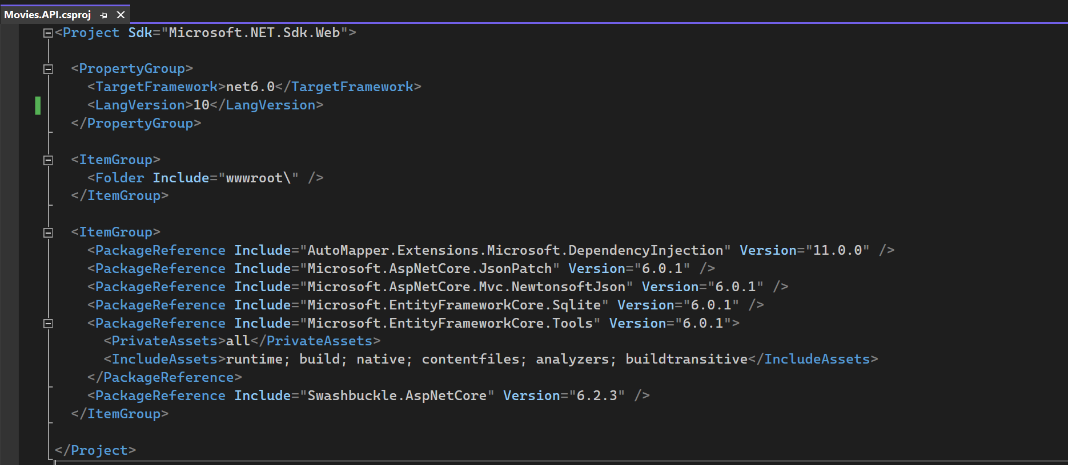
Starter project

Slide 4
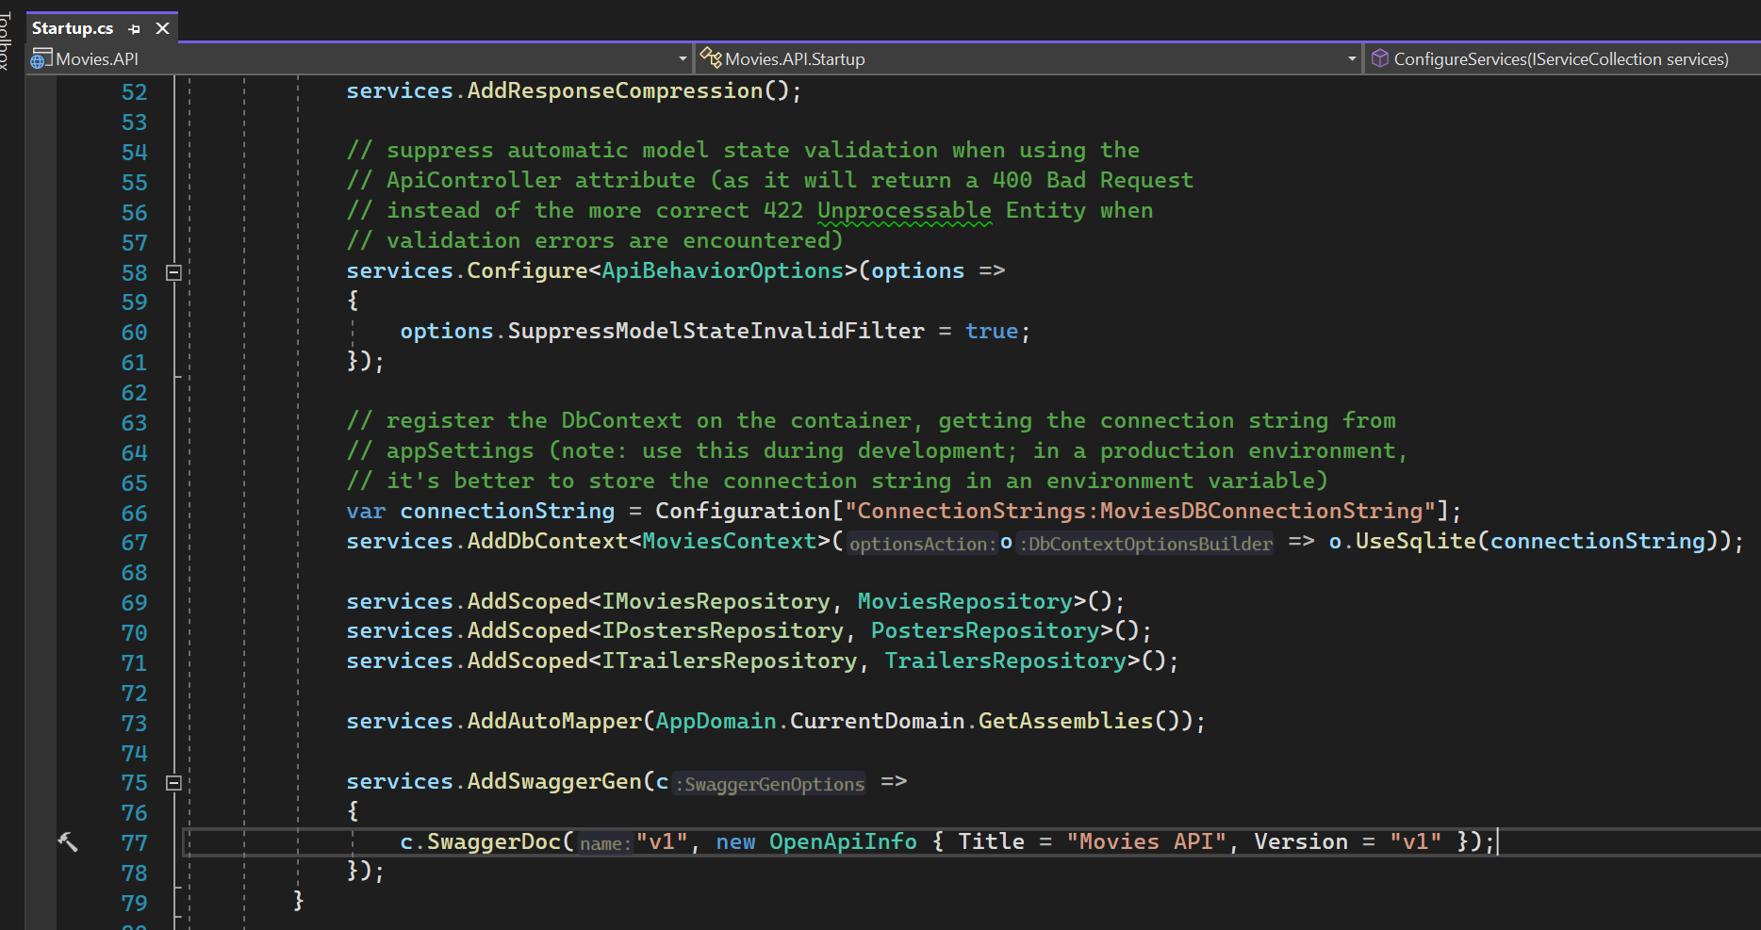
SQL LITE AS DATABASE

Slide 5
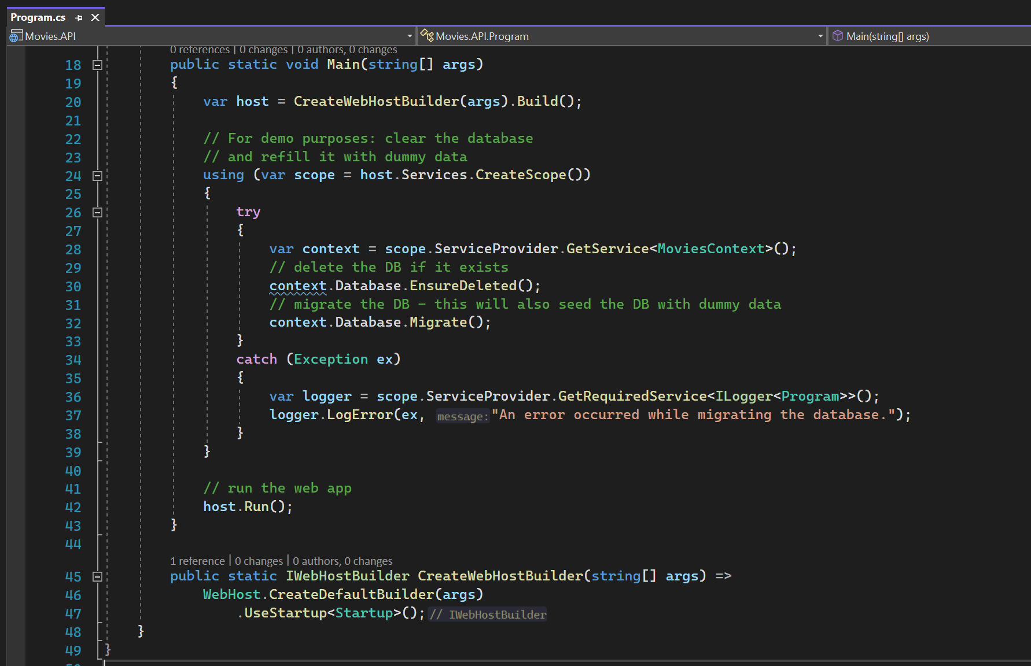
Databases are recreated

Slide 6
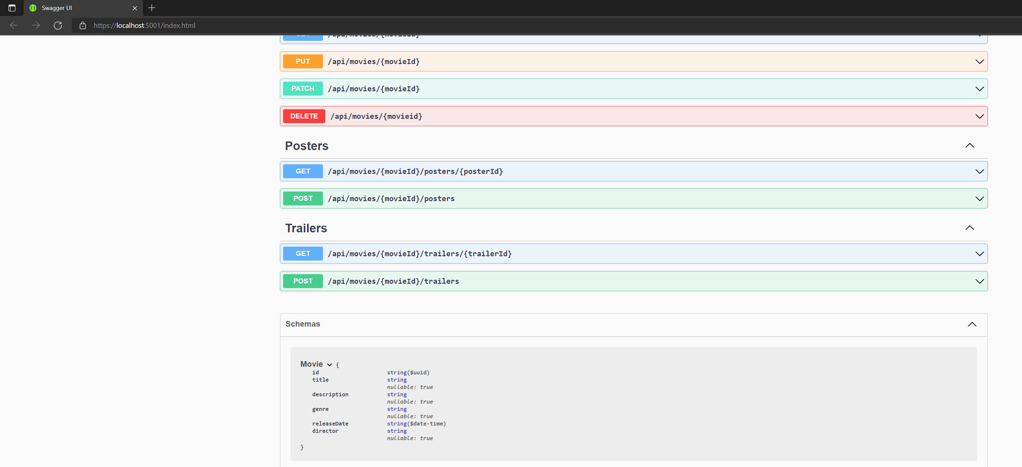
Exposed models

Slide 7
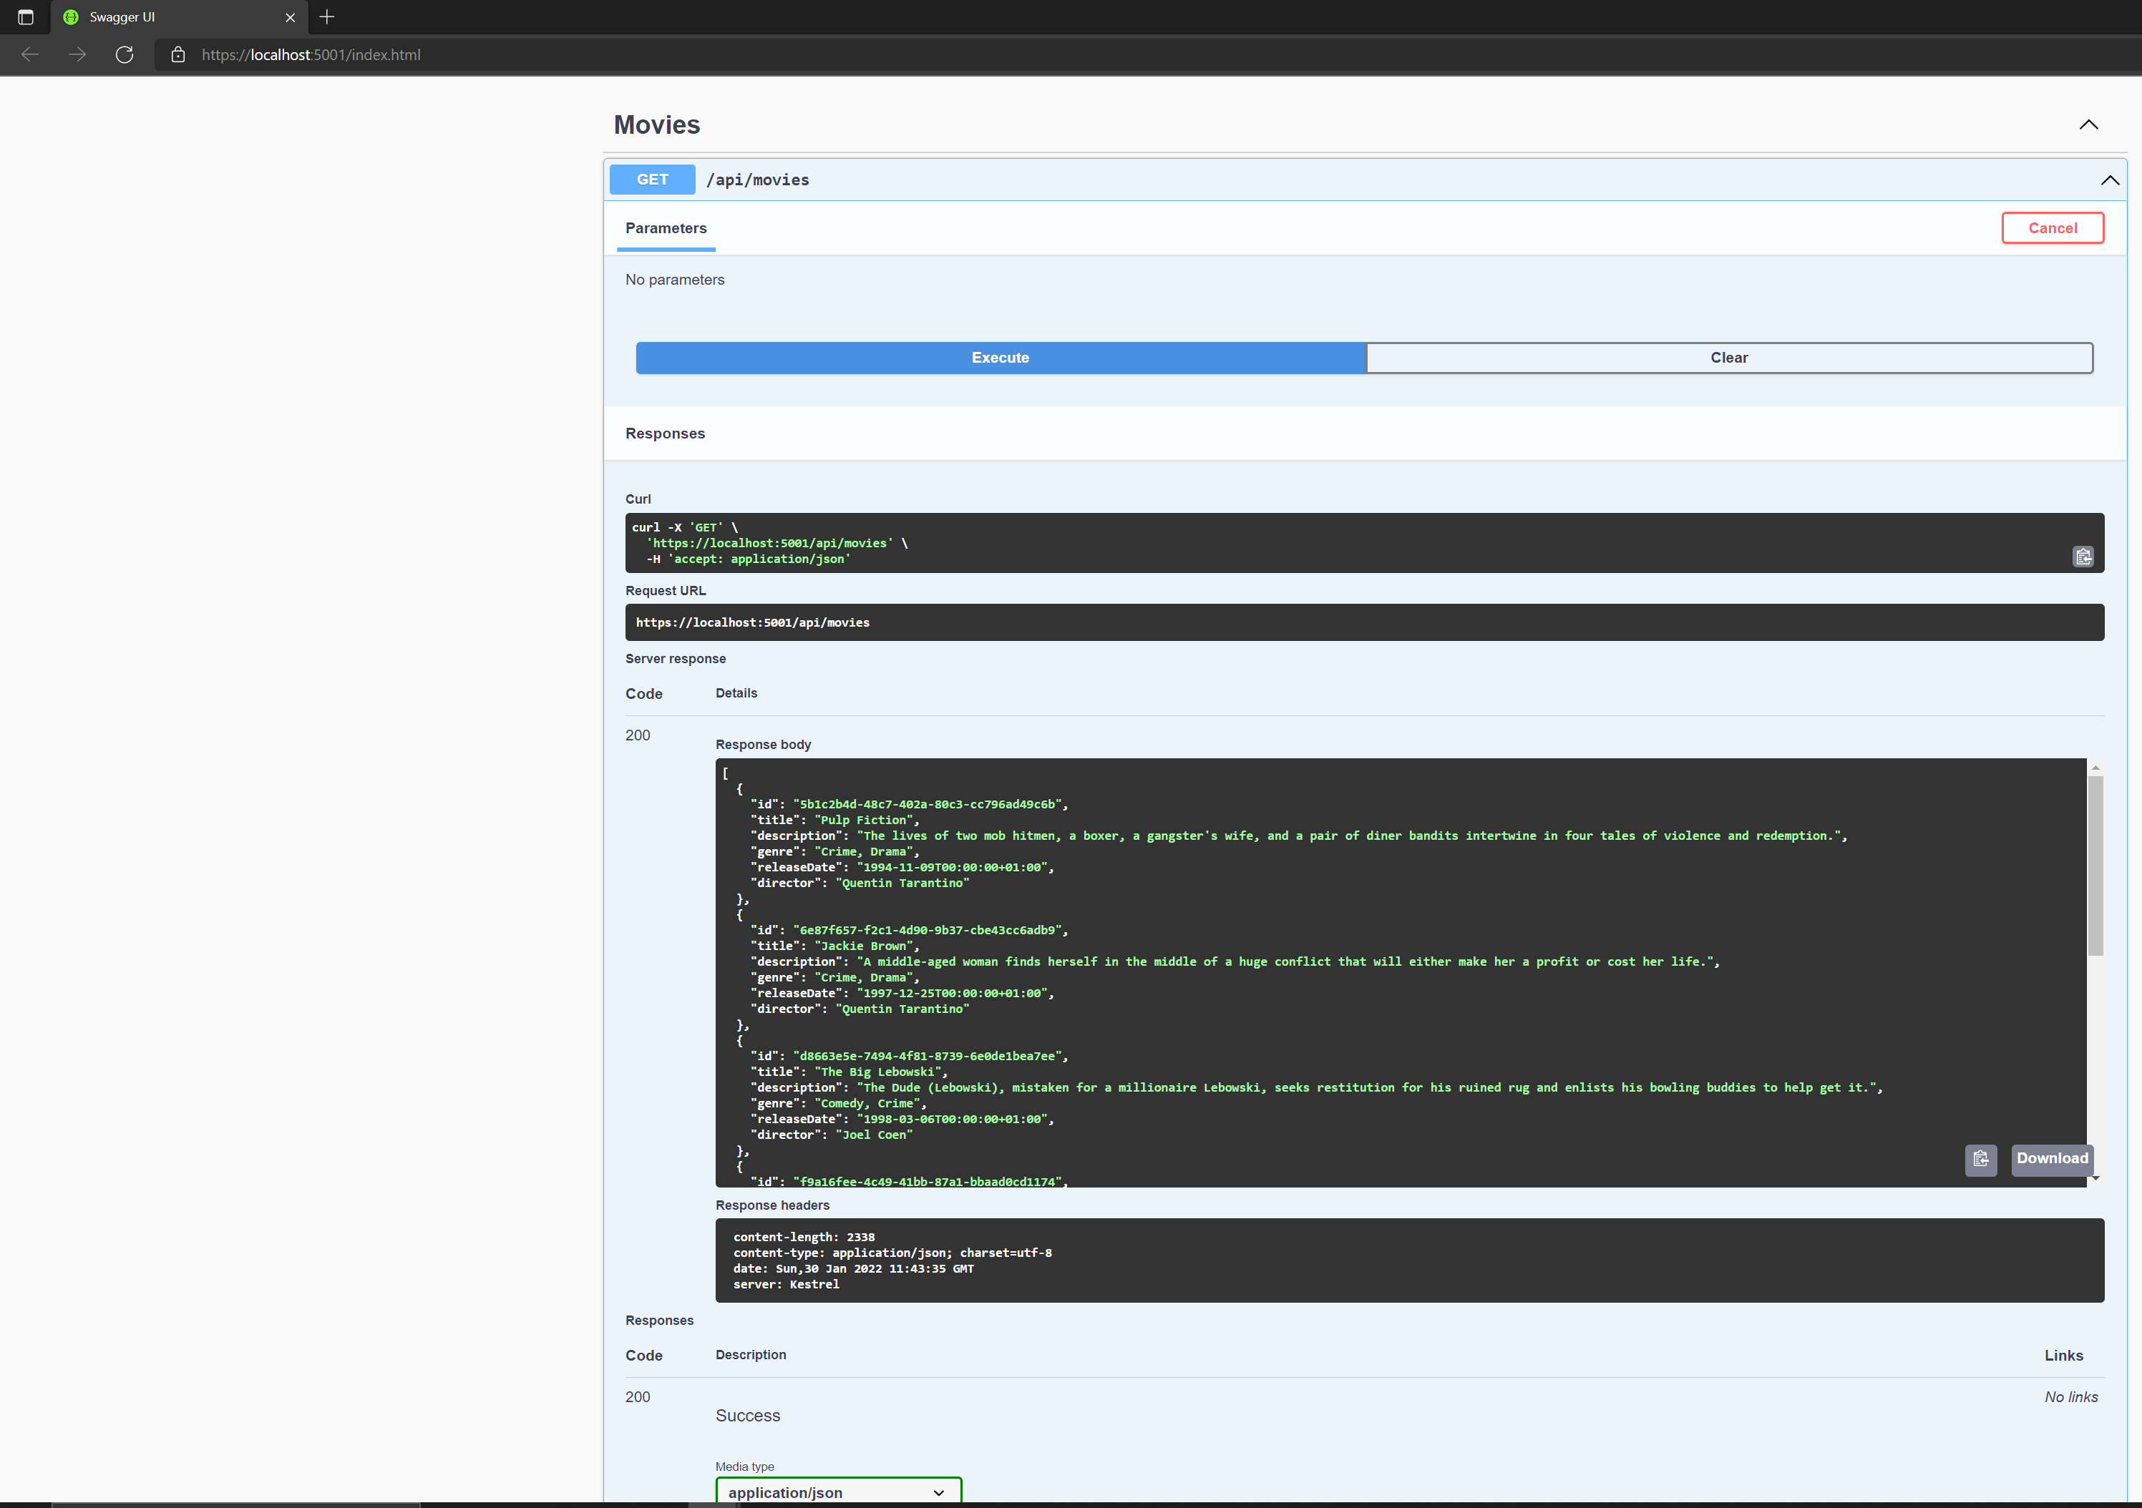
Setting up starter

Slide 8
Movie's client

Slide 9
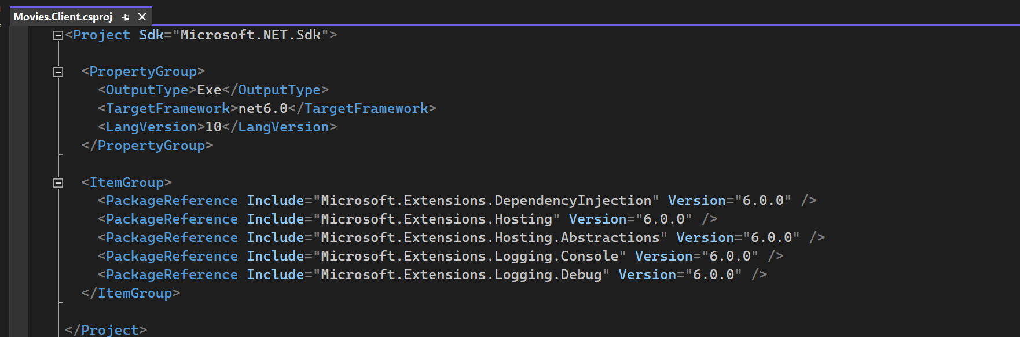
Client project details

Slide 10
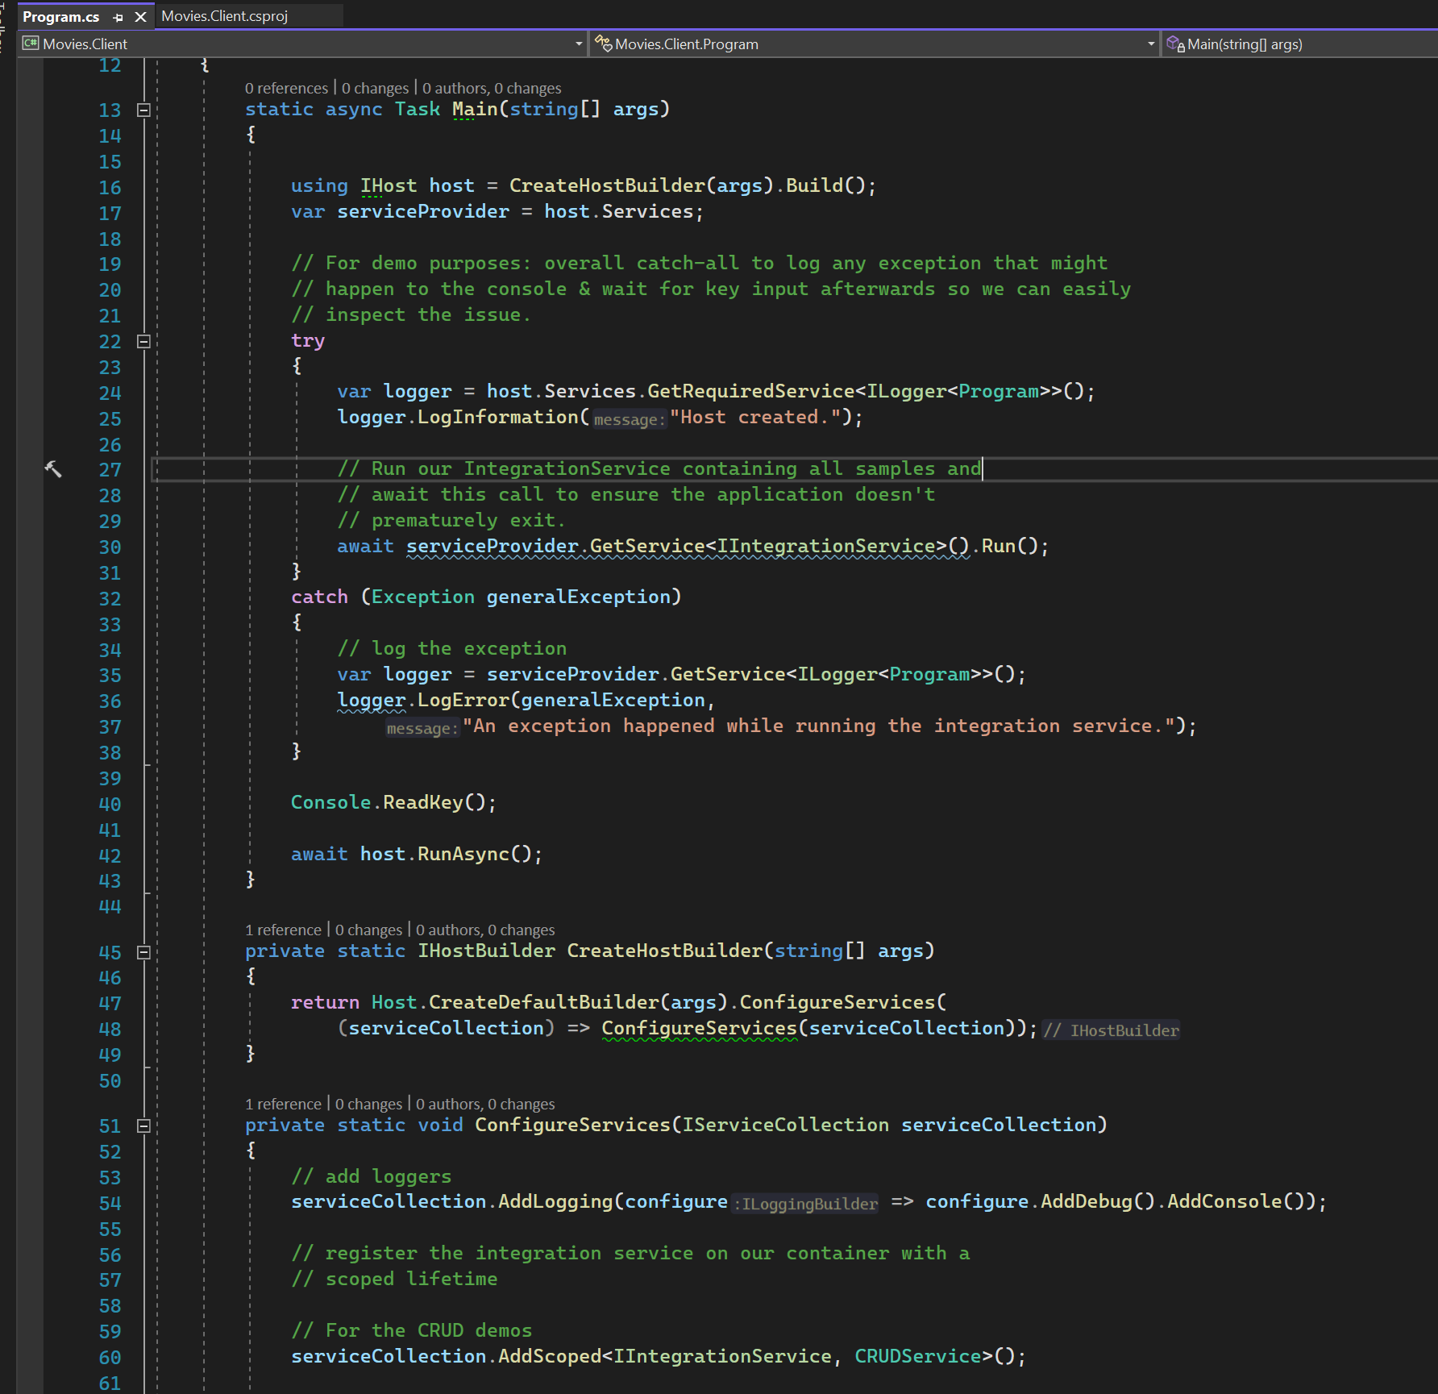
CLIENT BASIC SETUP

Slide 11
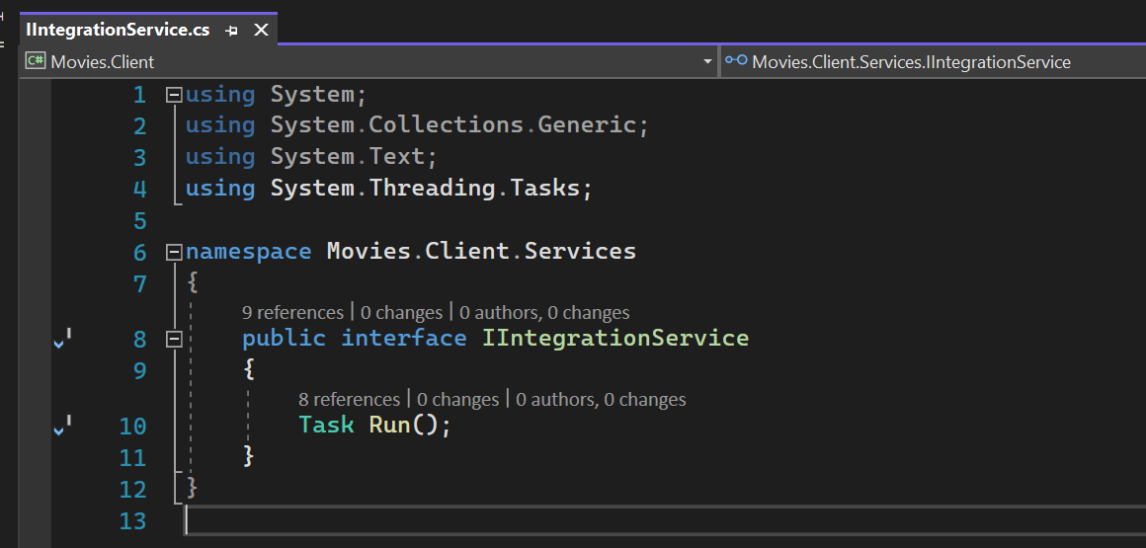
Integration service

Slide 12
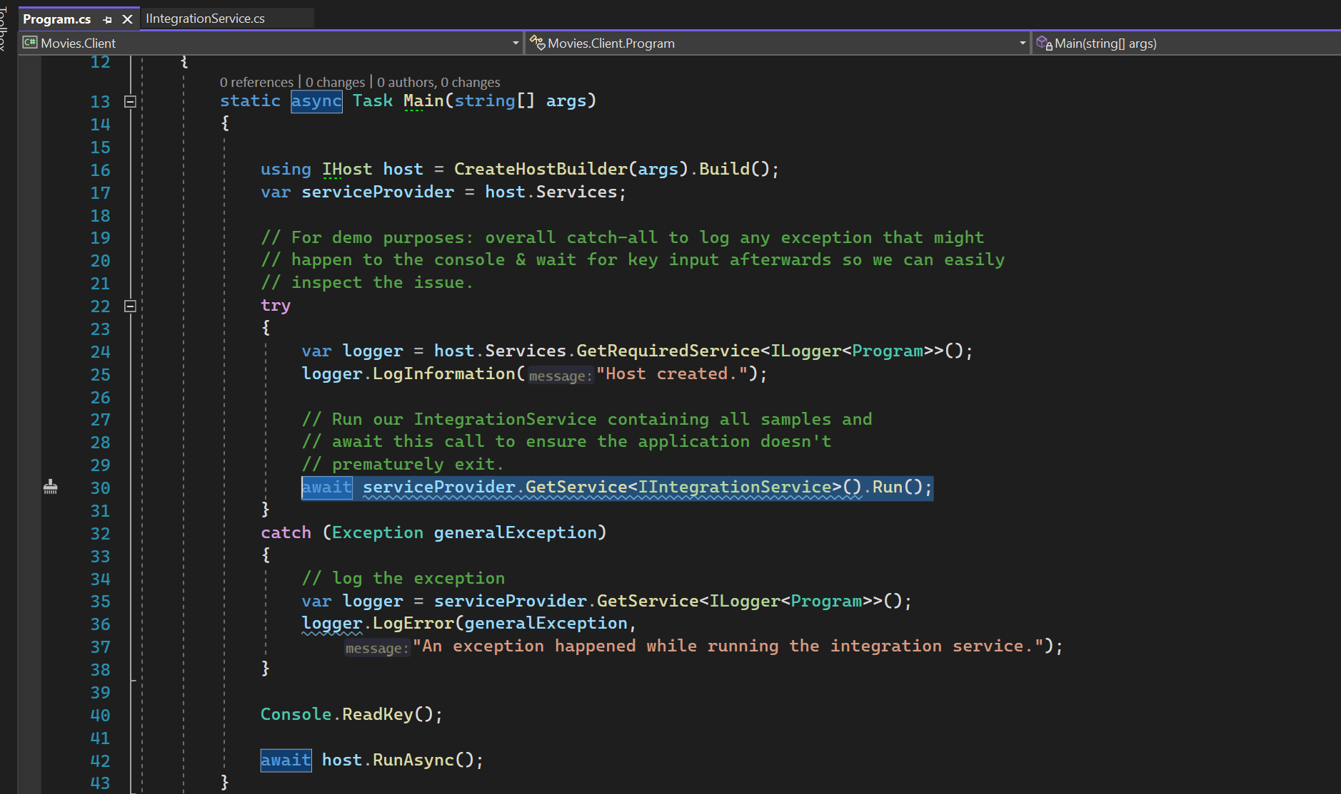
Integration service run method

Slide 13
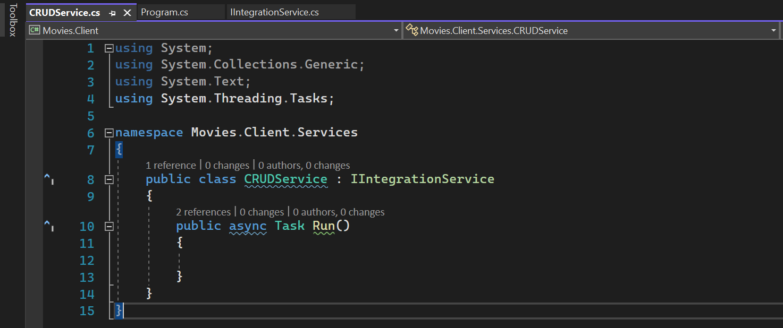
Crud service

Slide 14
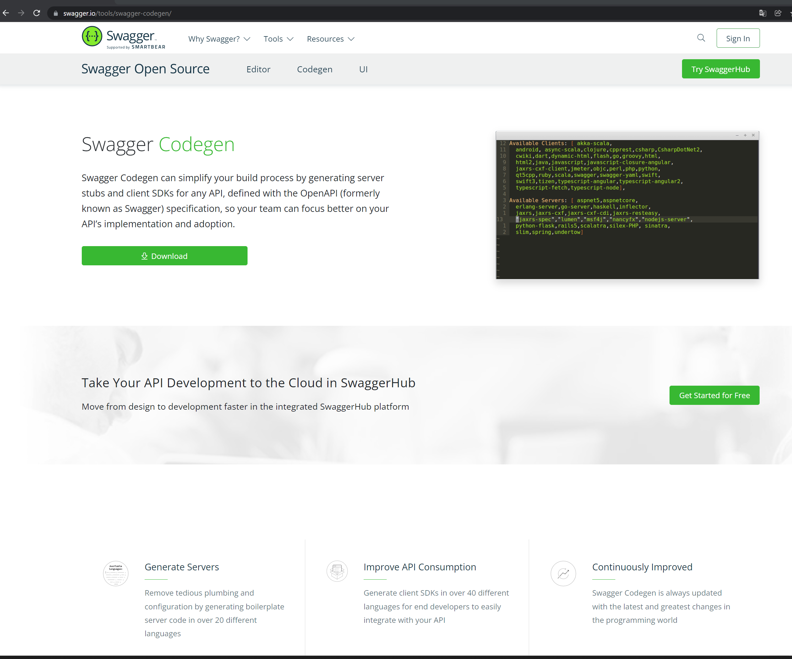
Generating dto classes - 1
https://swagger.io/tools/swagger-codegen/

Slide 15
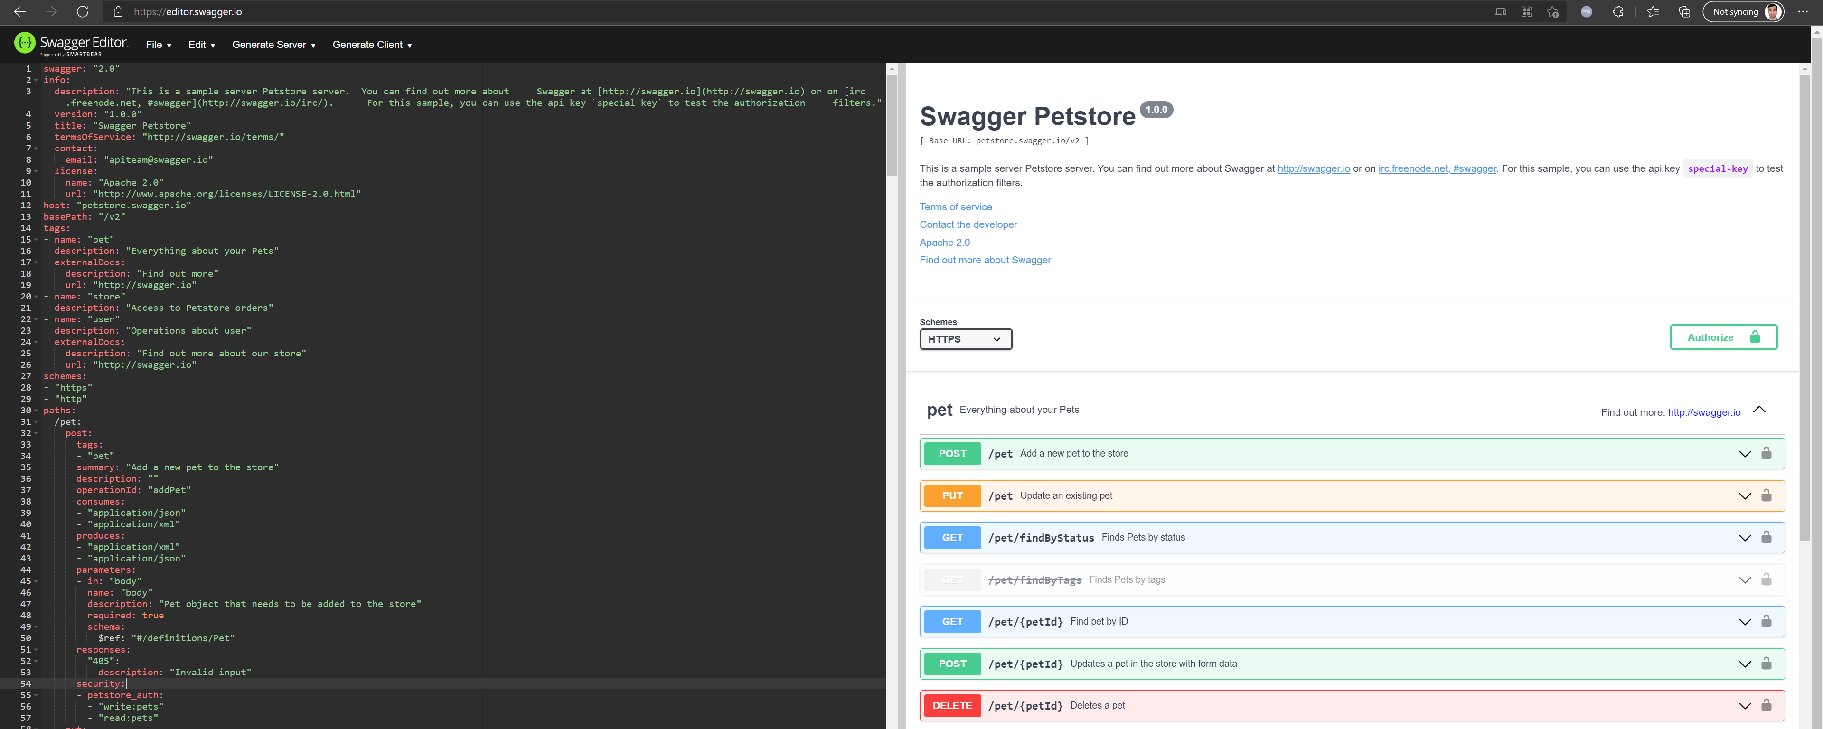
Generating dto classes - 2
Swagger Editor

Slide 16
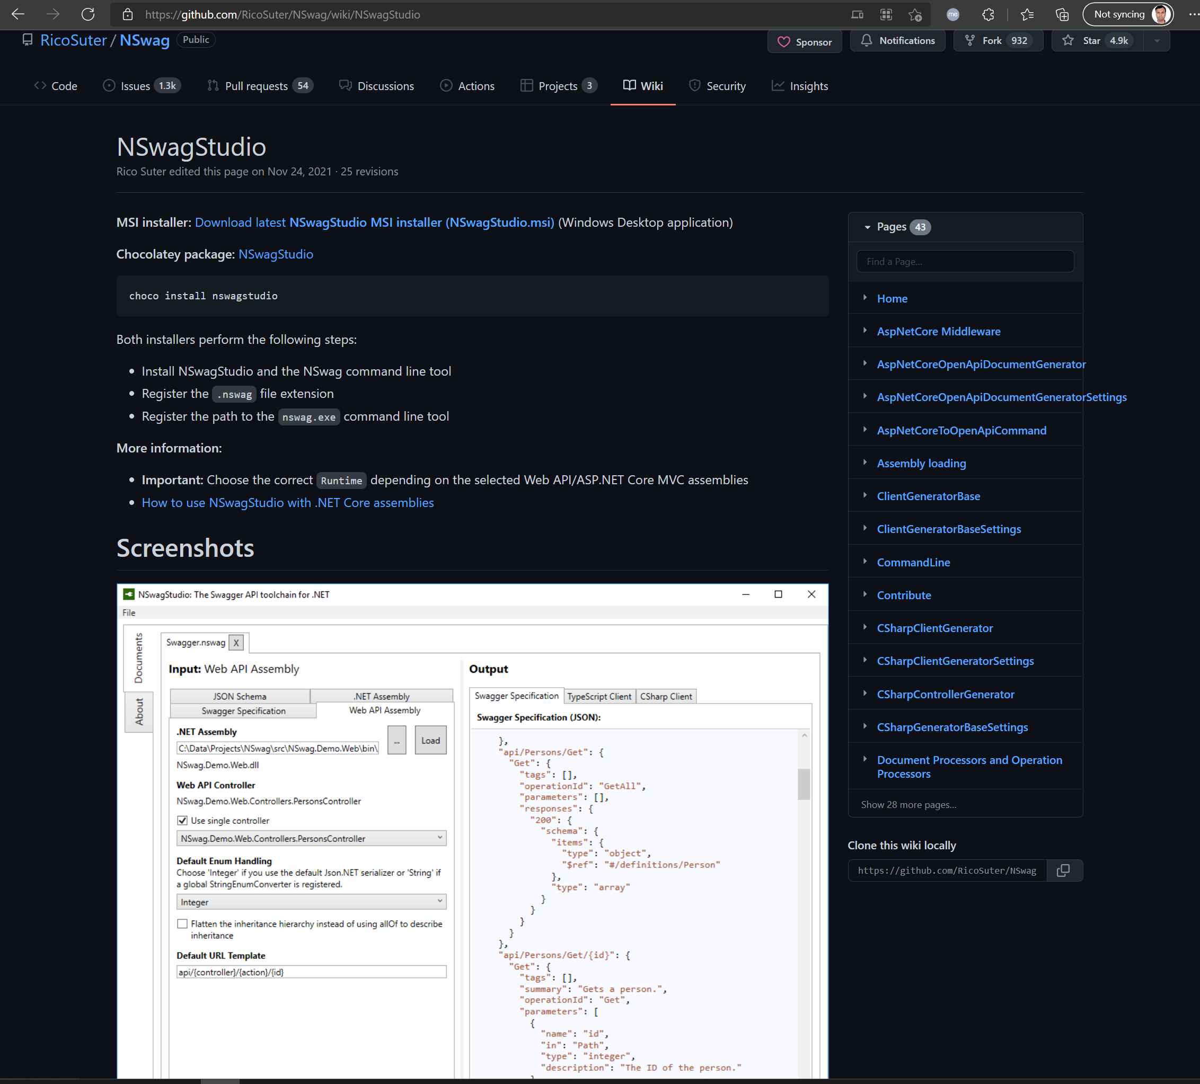
Generating dto classes - 3
NSwagStudio · RicoSuter/NSwag Wiki · GitHub

Slide 17
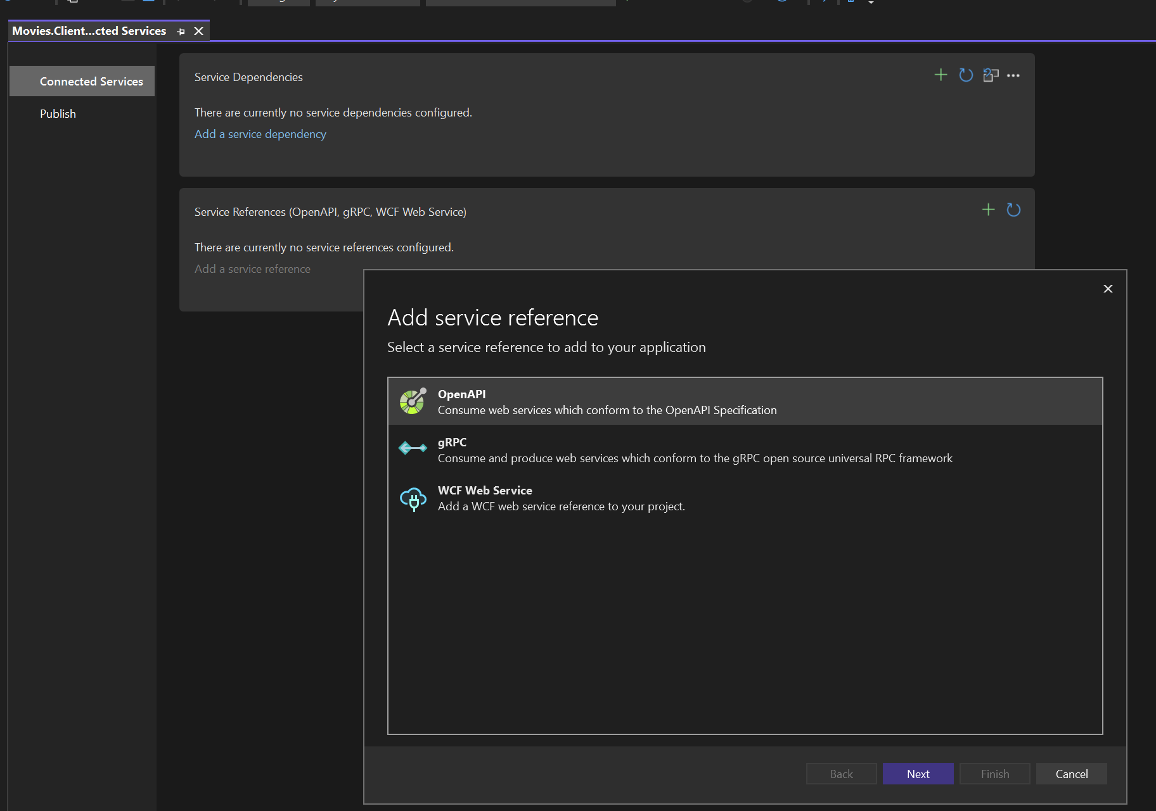
Generating dto classes - 4
Add connected service

Slide 18
Generating dto classes from visual studio

Slide 19
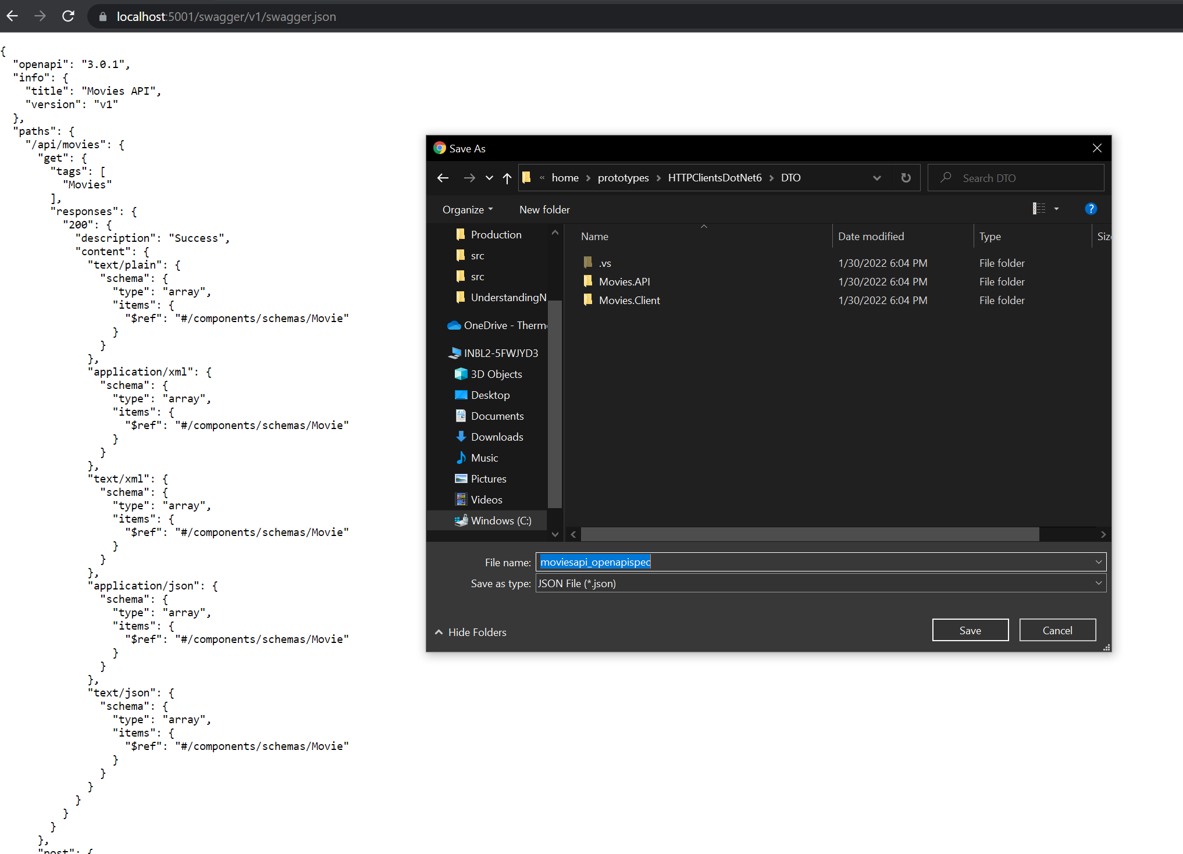
MOVIES OPEN API SPEC

Slide 20
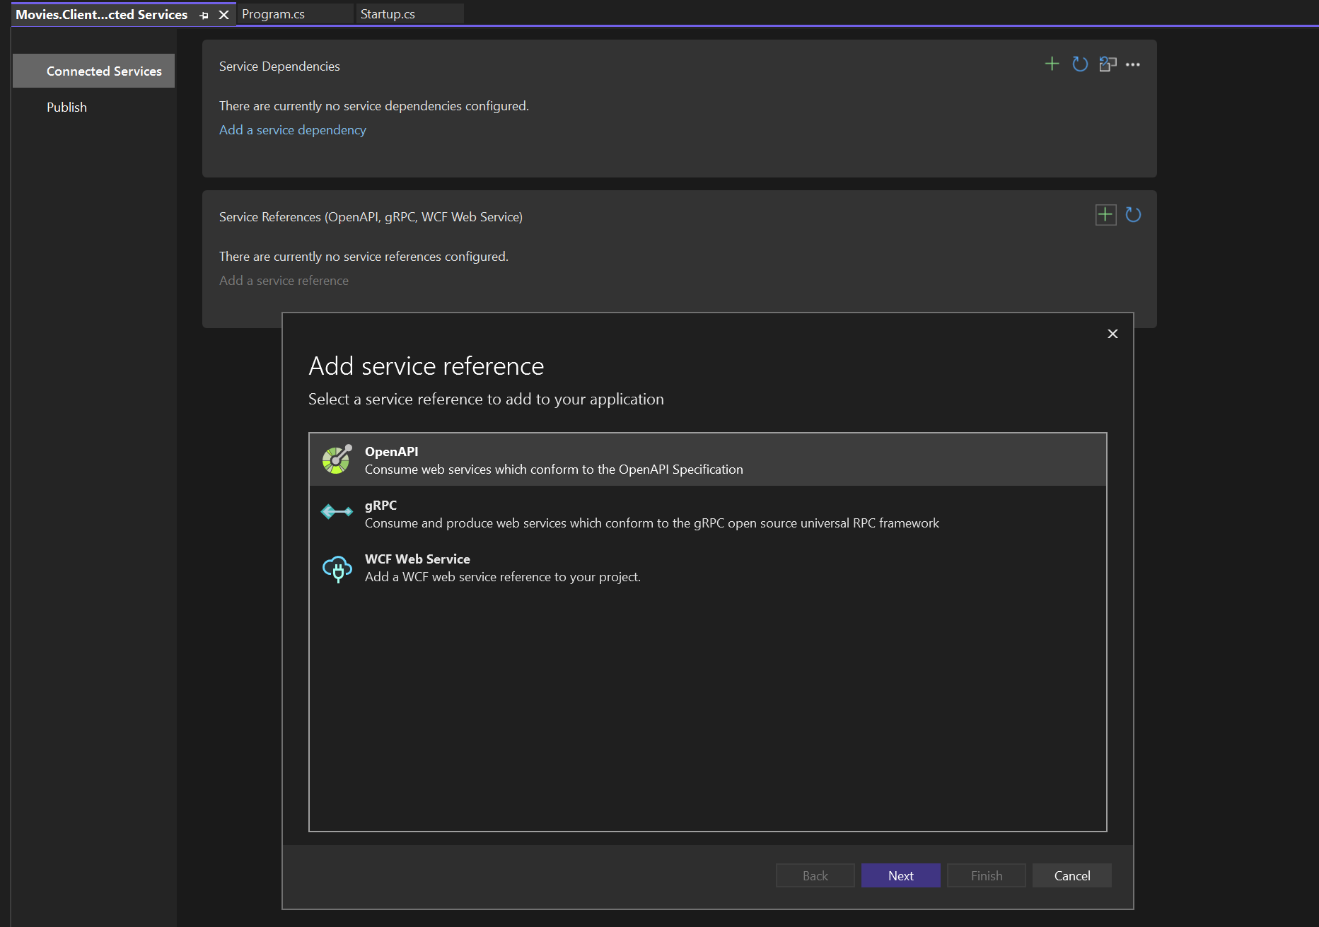
openAPI

Slide 21
openAPI

Slide 22
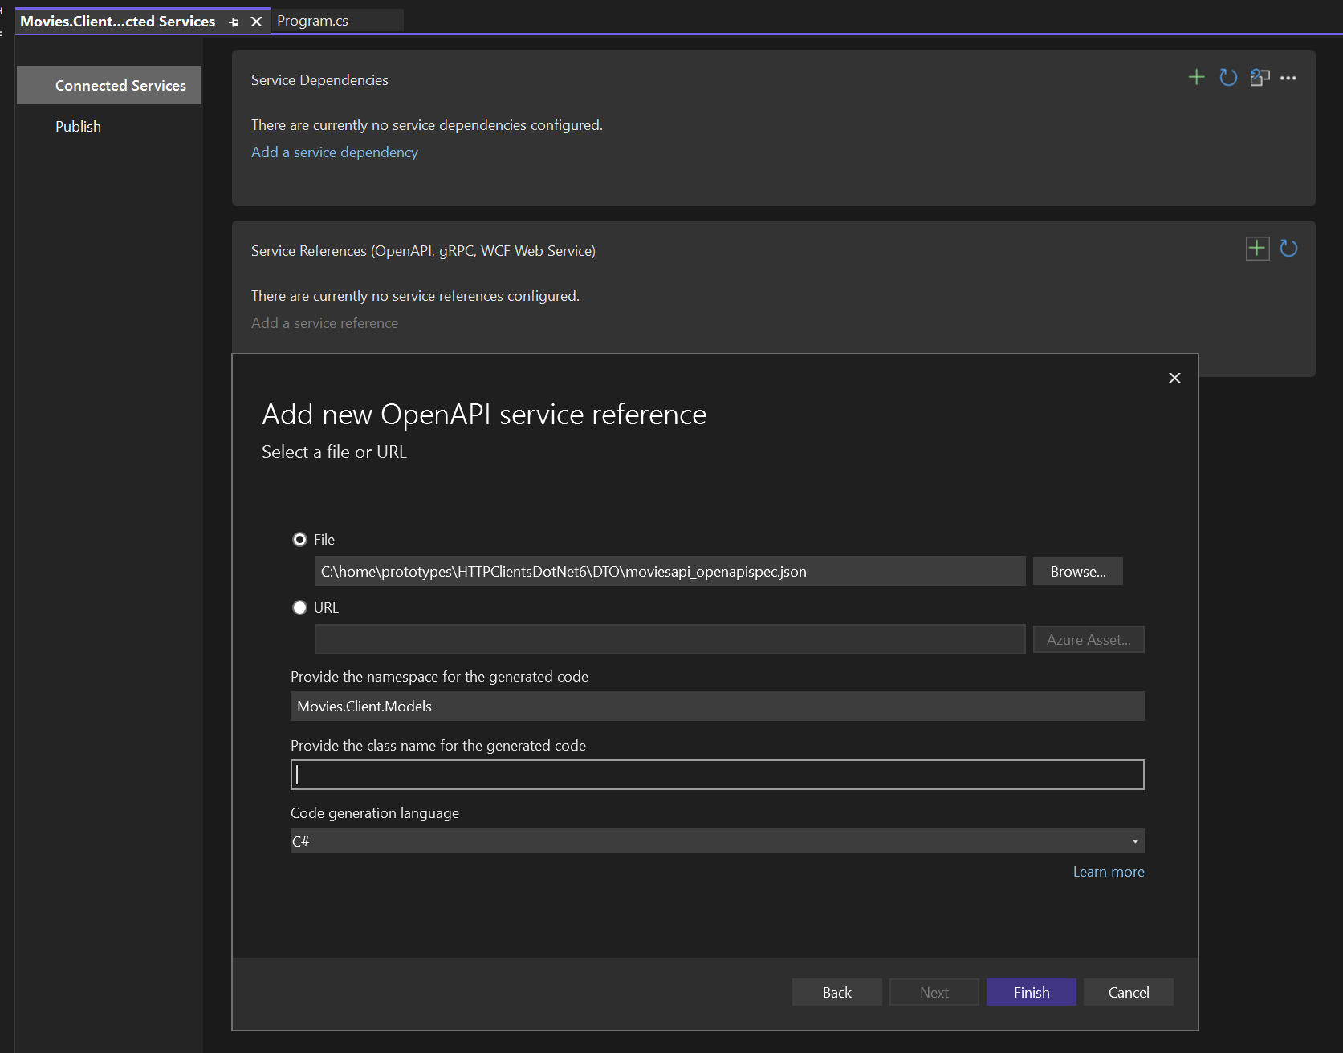
openAPI service reference

Slide 23
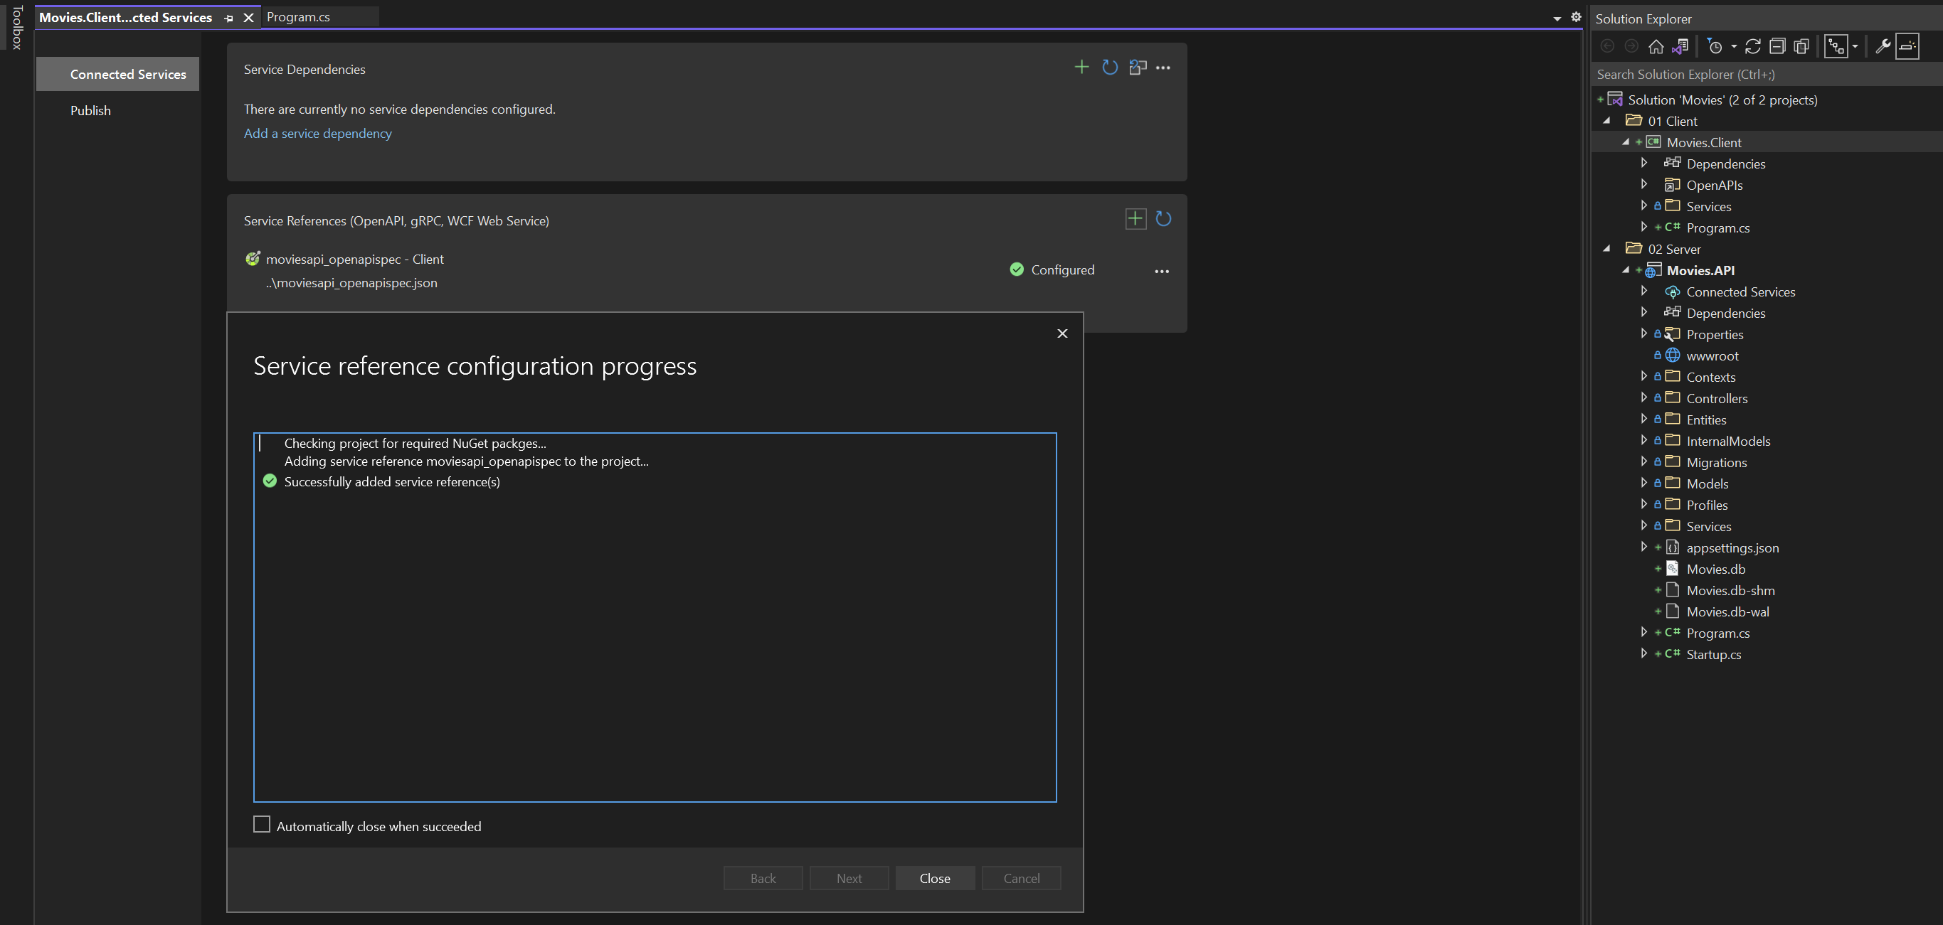
openAPI service reference

Slide 24
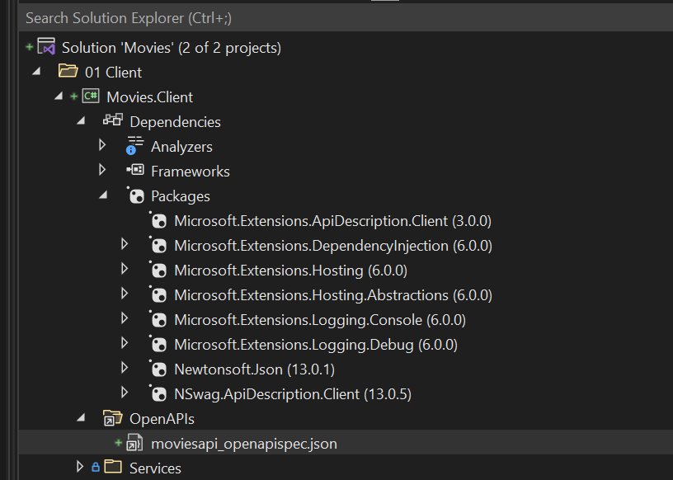
openAPI service reference

Slide 25
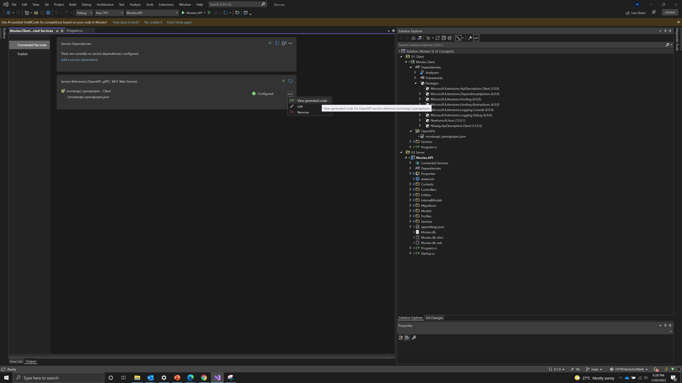
openAPI service reference

Slide 26
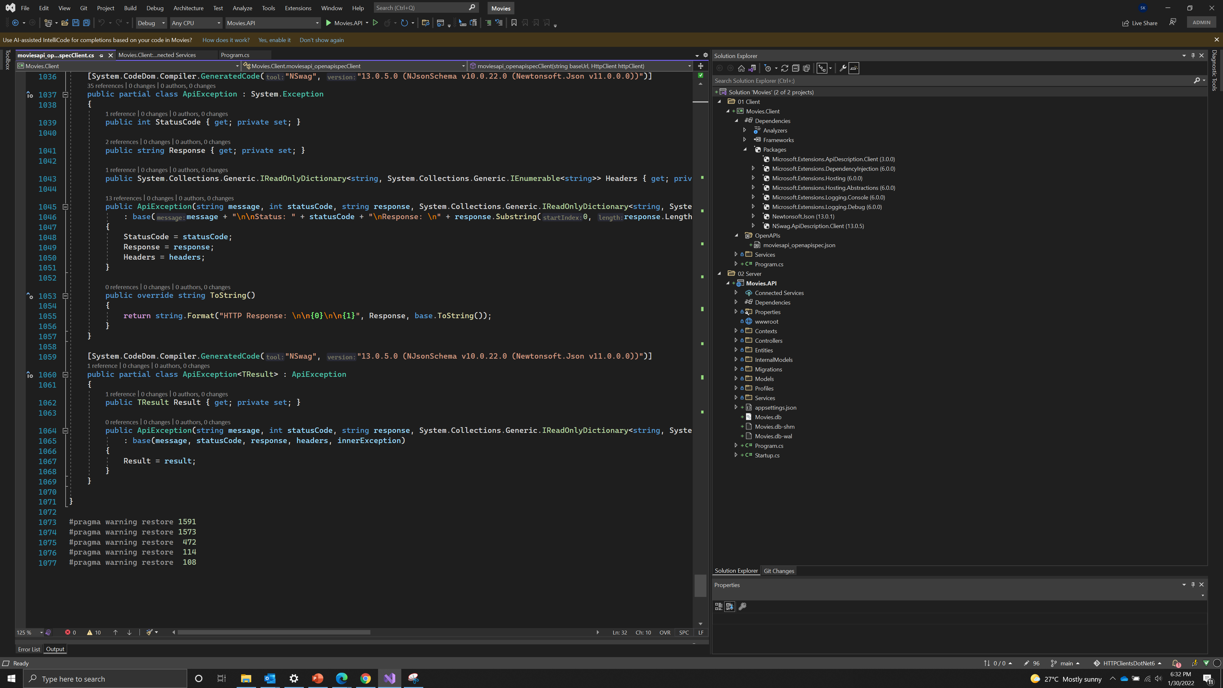
Lot of code – Good for prototypes but not for production

Slide 27
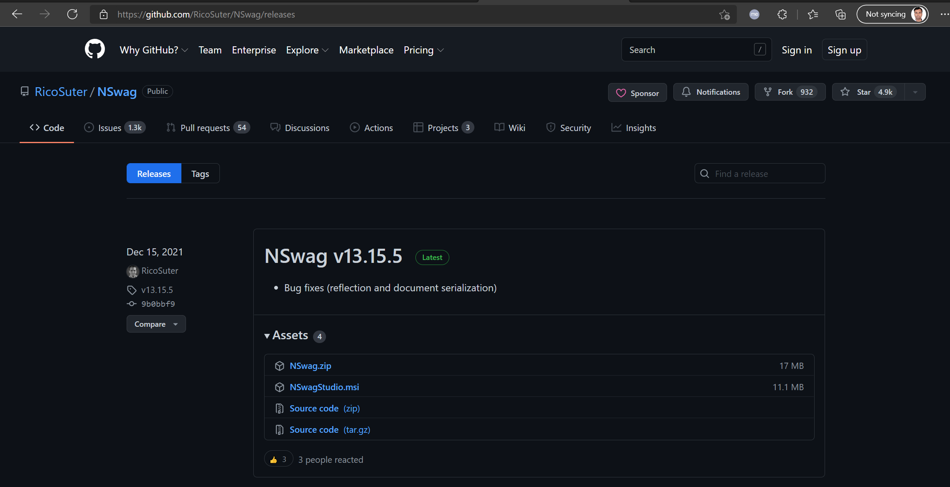
Install Nswag studio

Slide 28
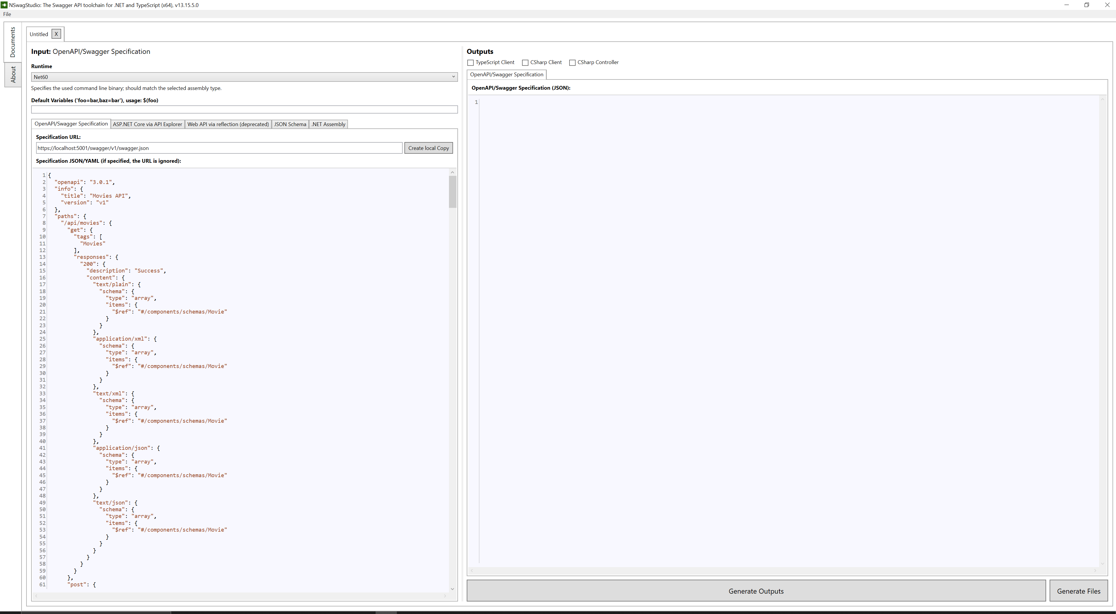
Nswag studio – create local copy

Slide 29
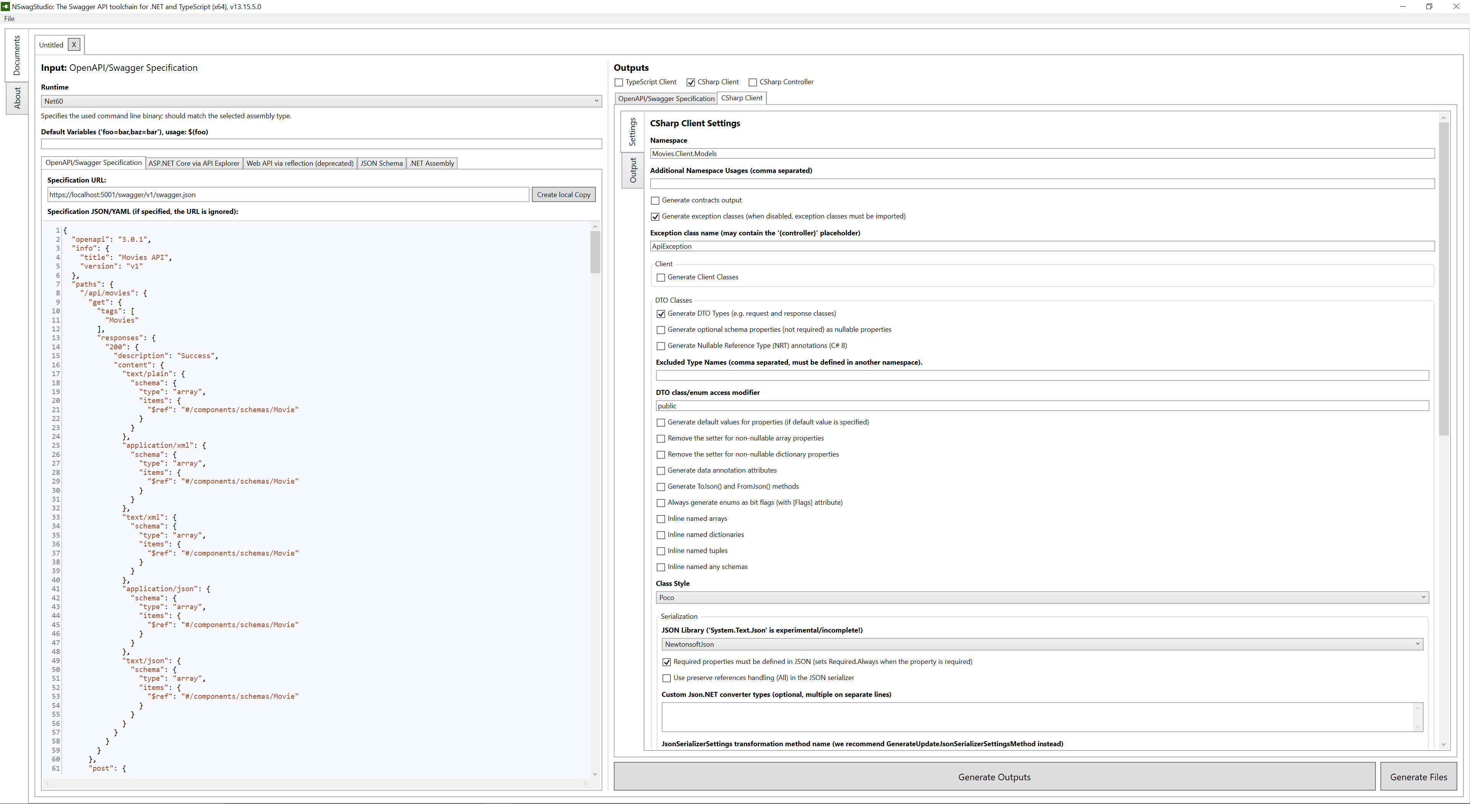
Nswag studio - 1

Slide 30
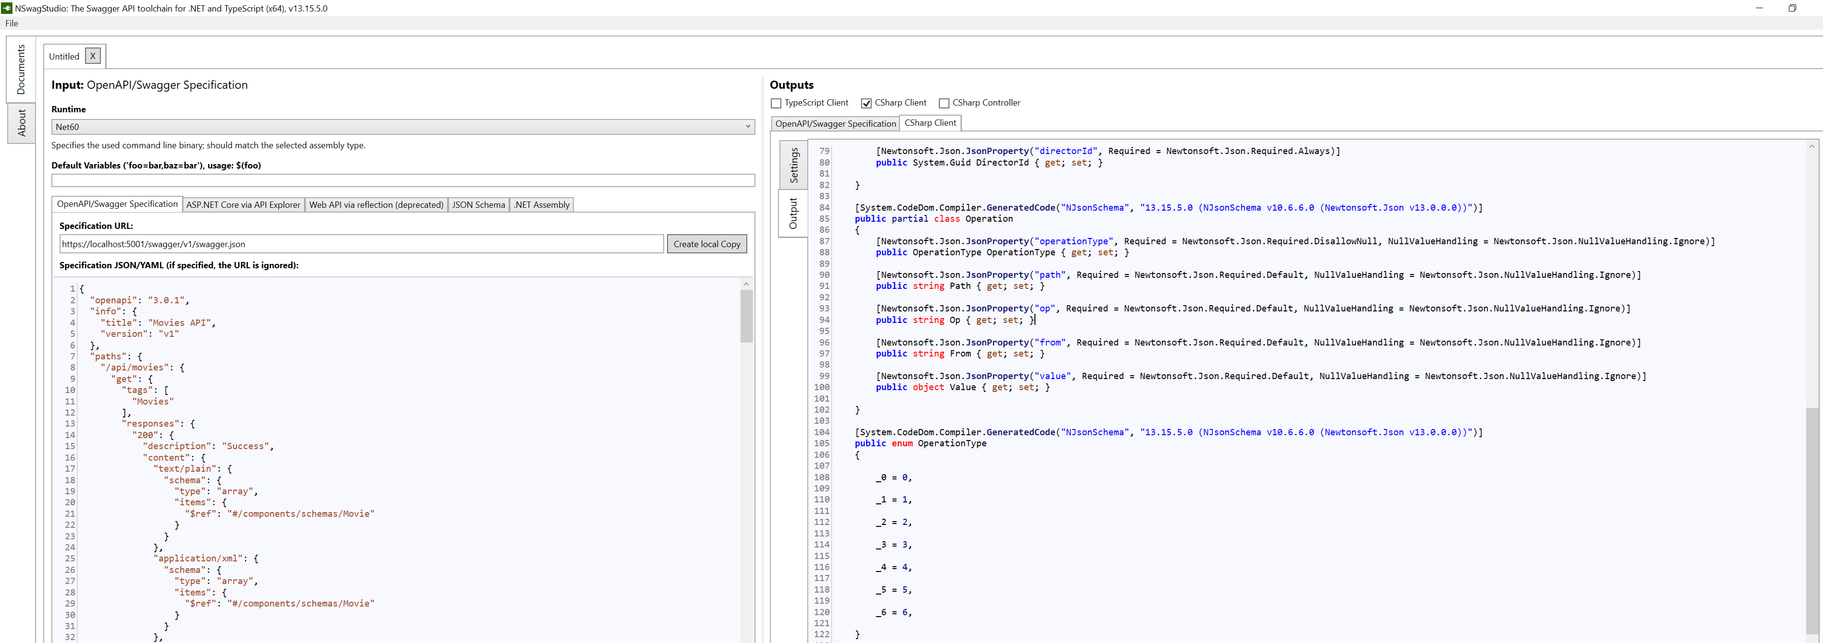
Nswag studio – 2 – Operation, operation type

Slide 31
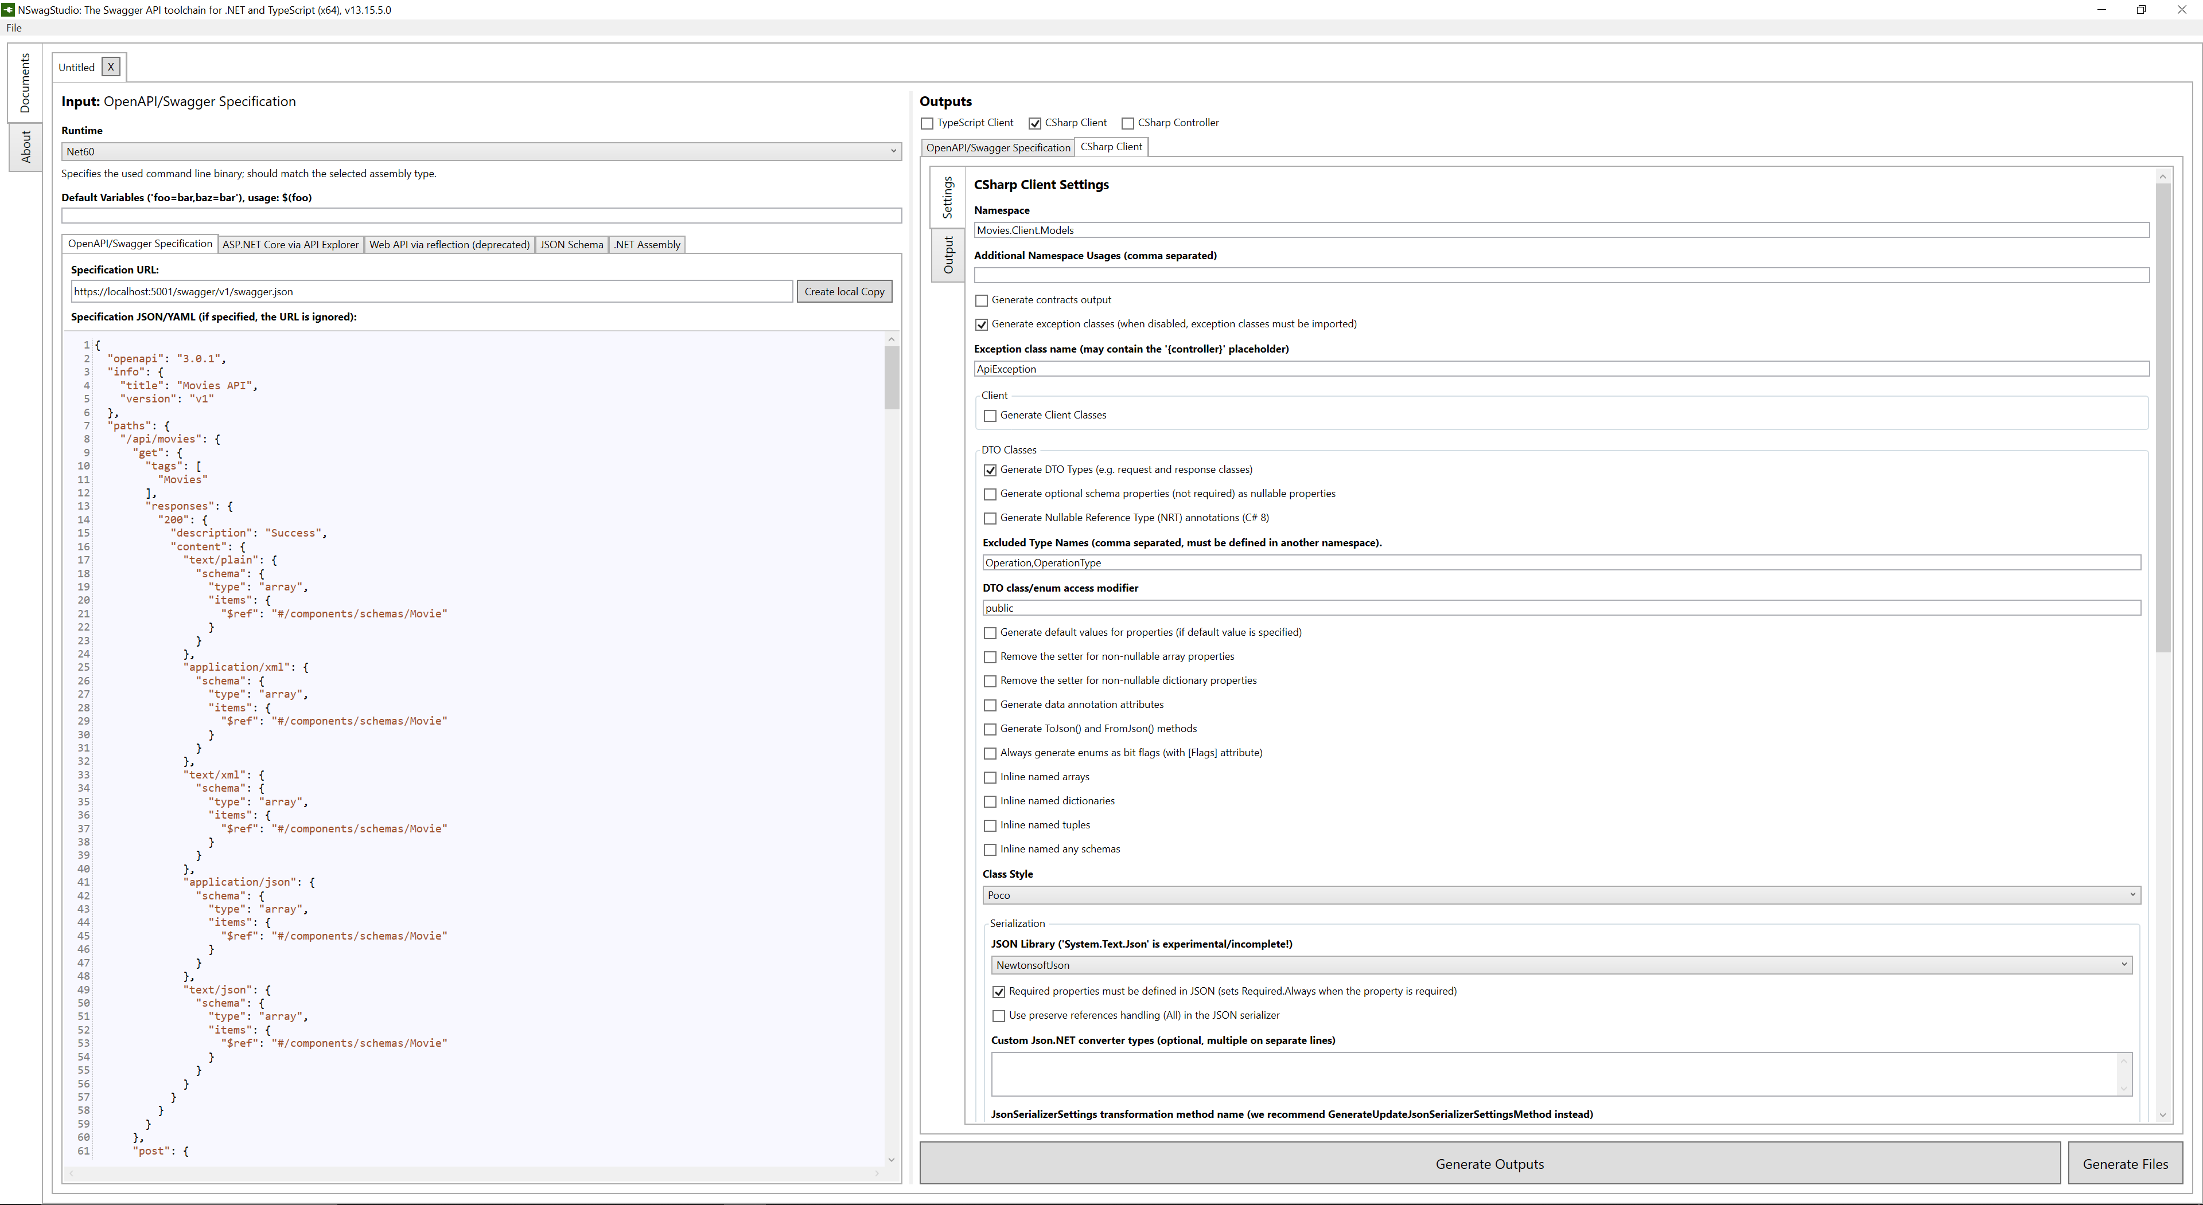
Nswag studio – 3 – exclude Operation, operation type

Slide 32
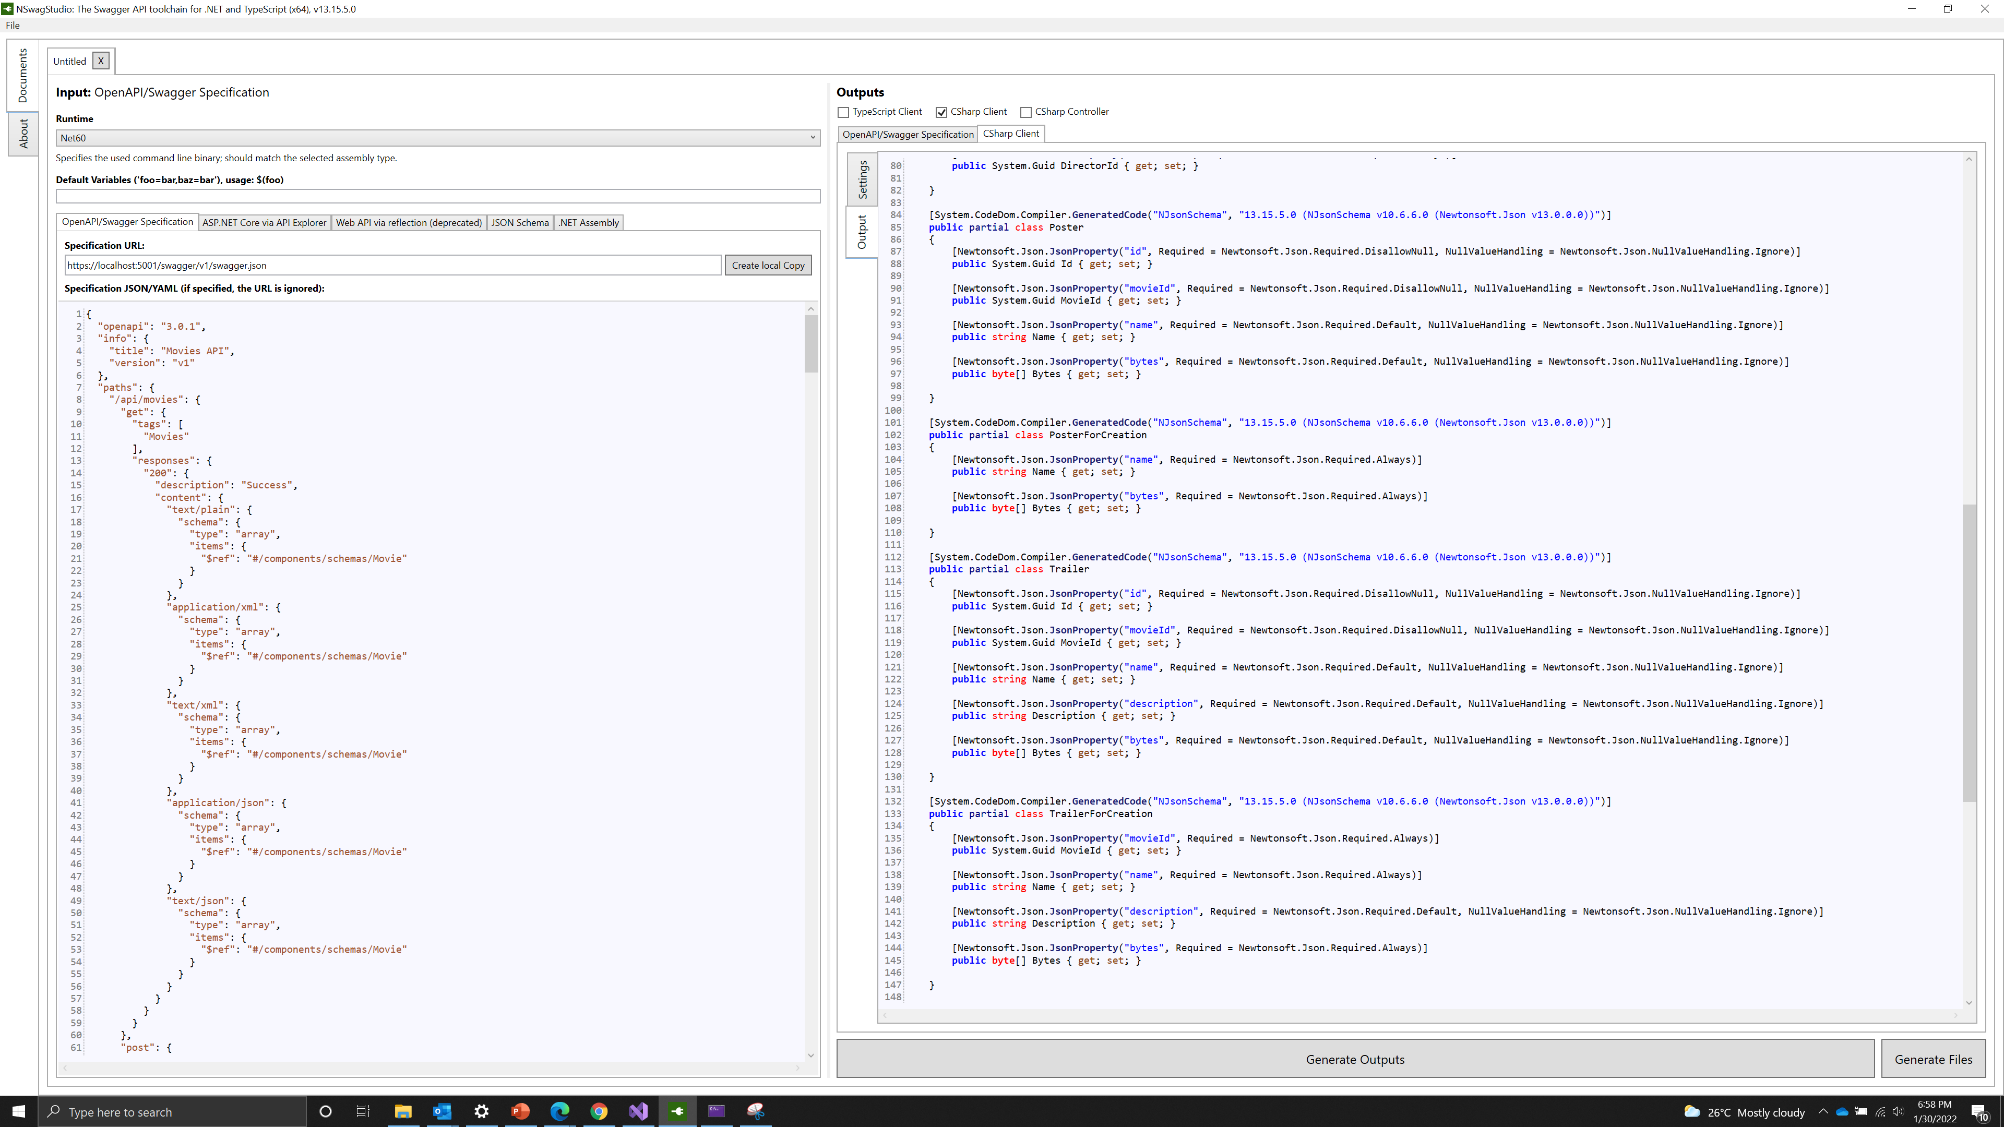
Nswag studio – 4 – generated dto models

Slide 33
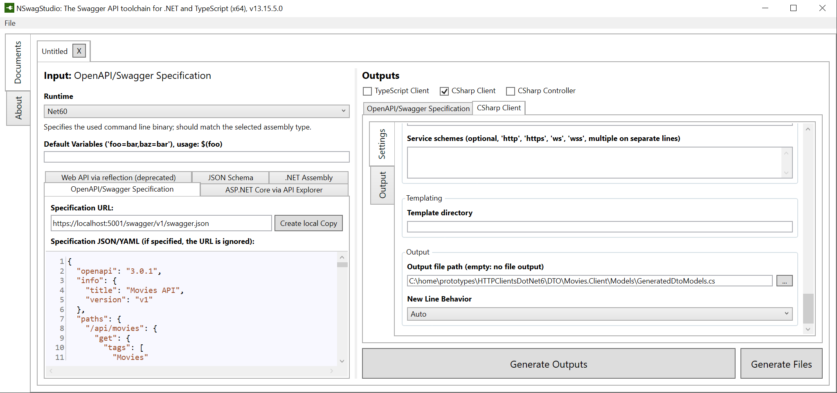
Nswag studio – 5 – set output path

Slide 34
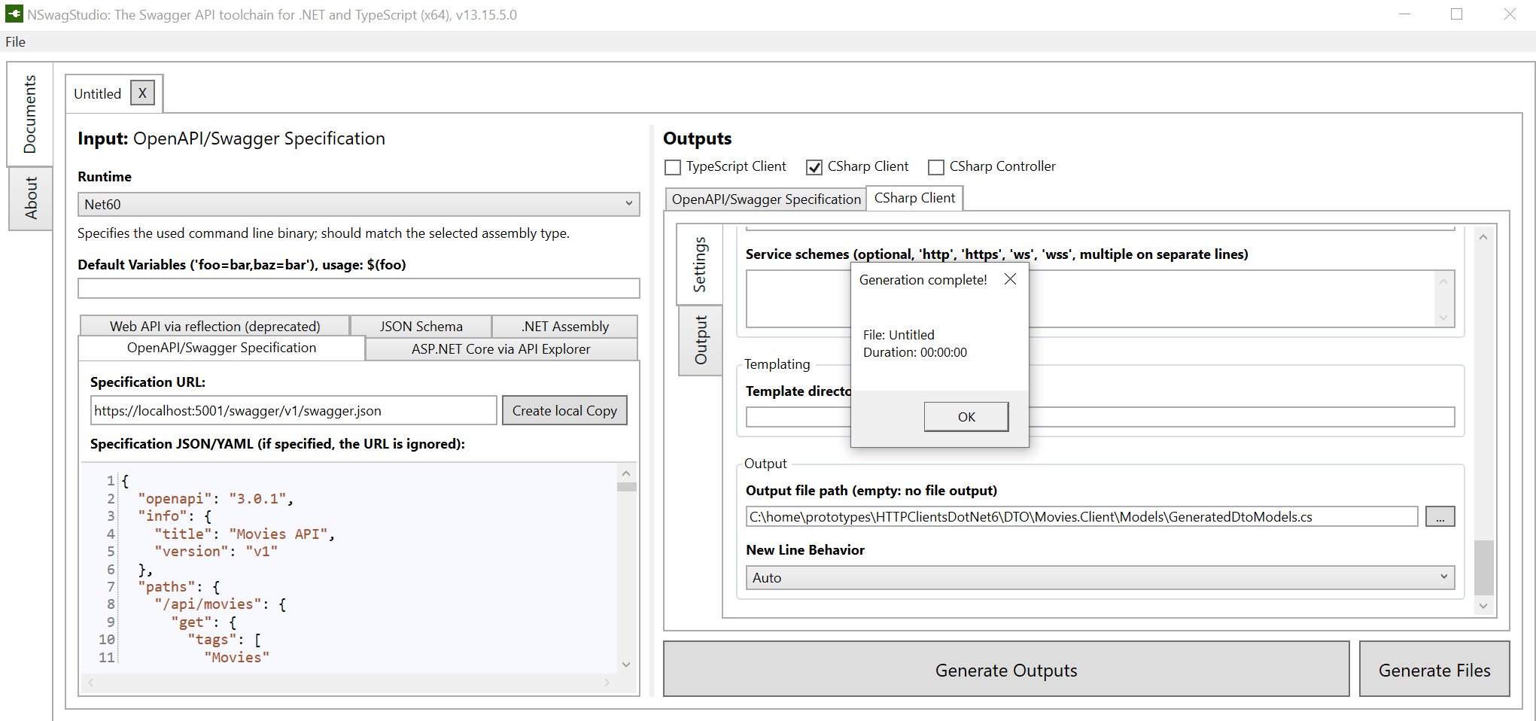
Nswag studio – 6 – generate files

Slide 35
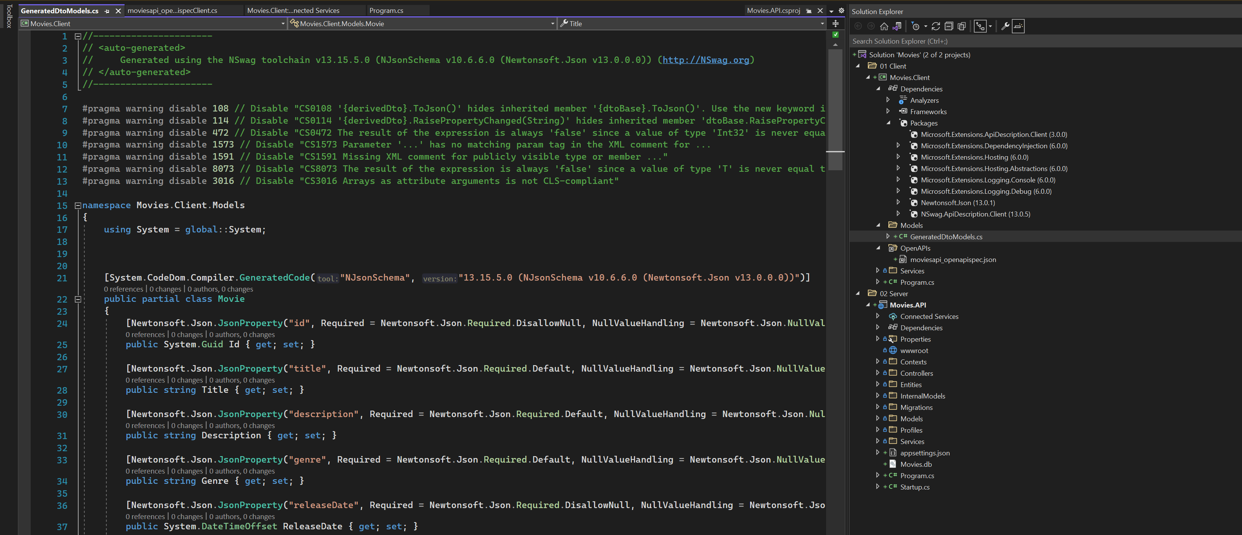
Nswag studio - 7

Slide 36
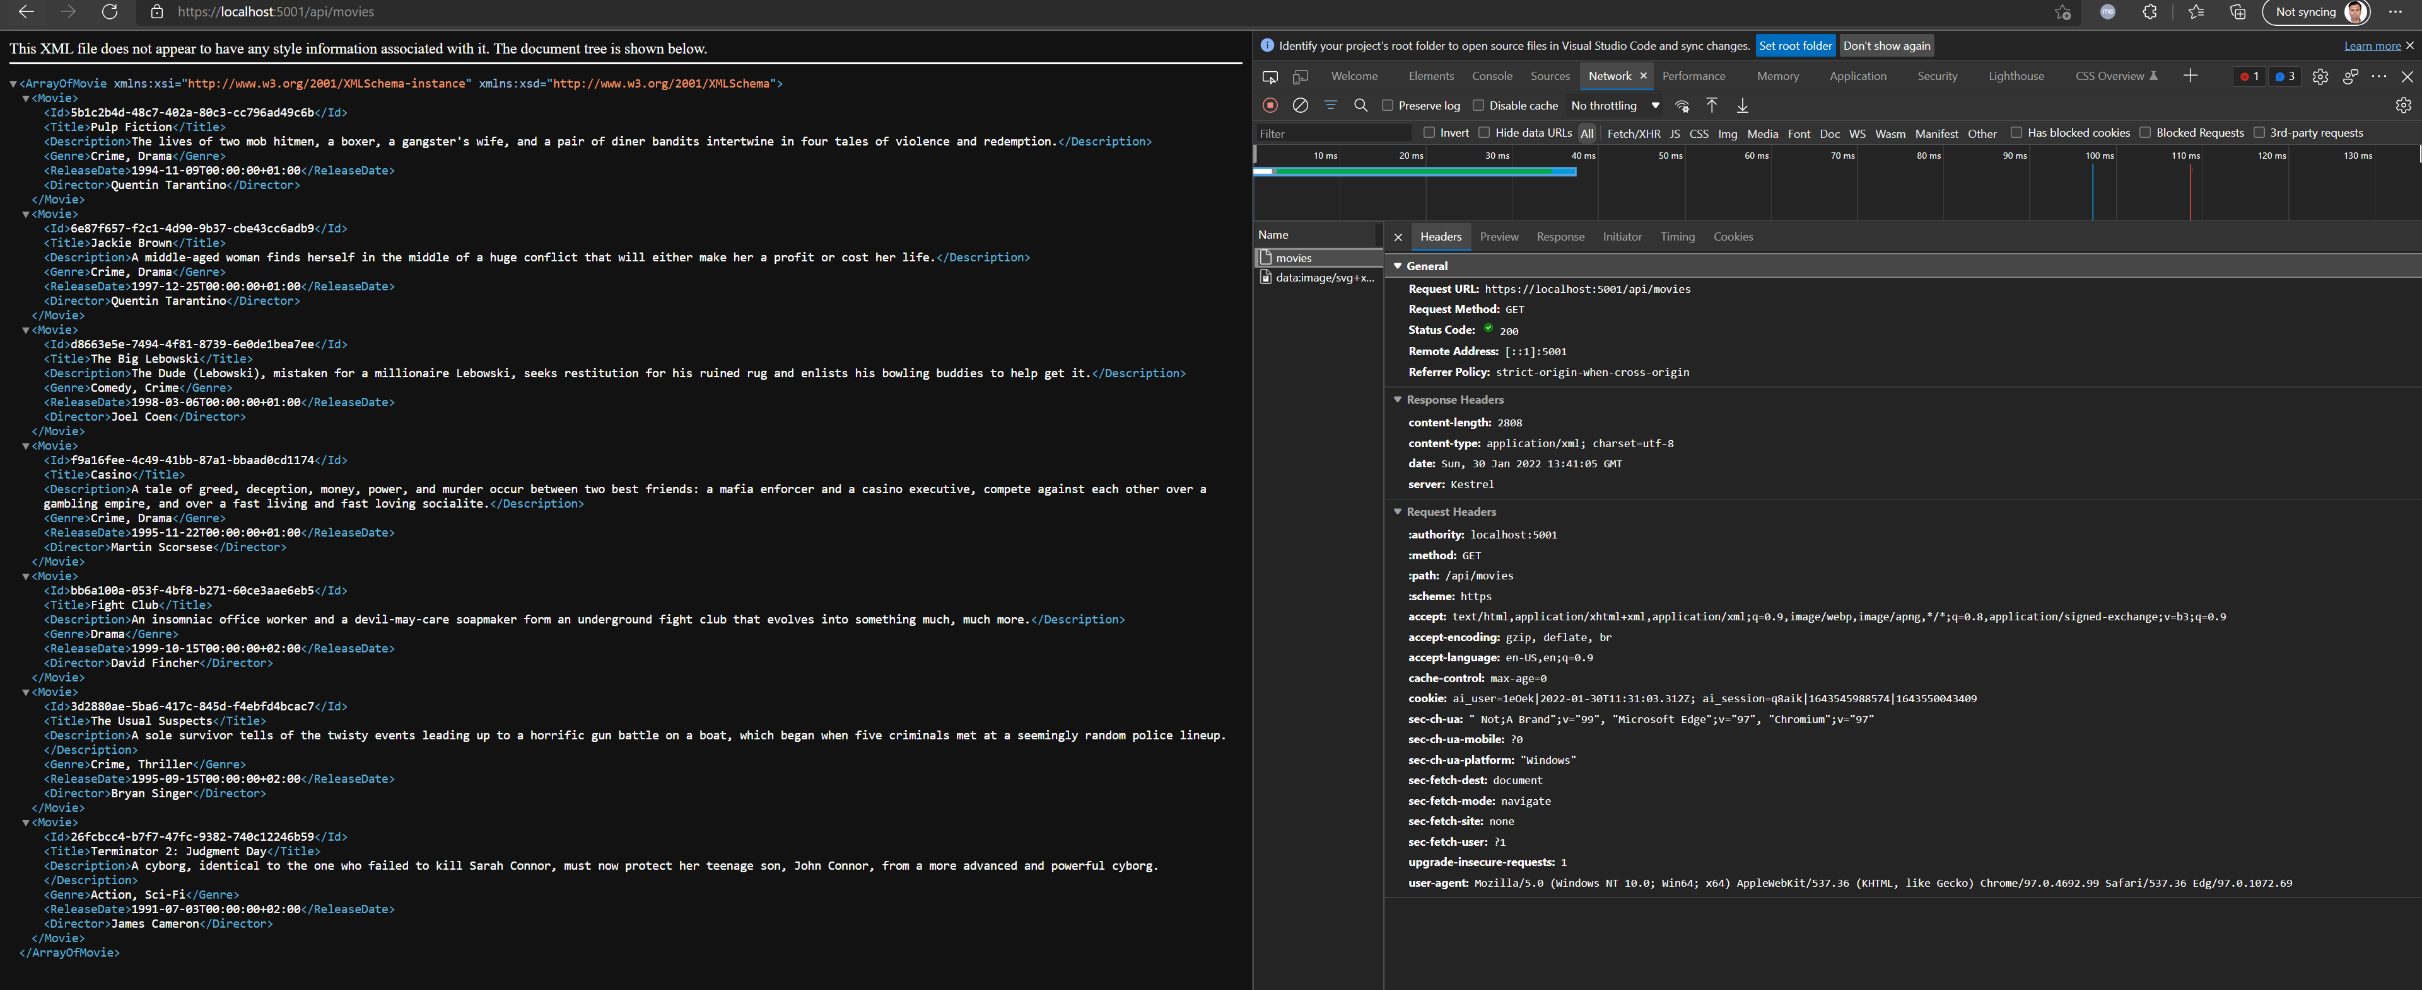
GET MOVIES – browser default requests xml

Slide 37
Crud operations

Slide 38
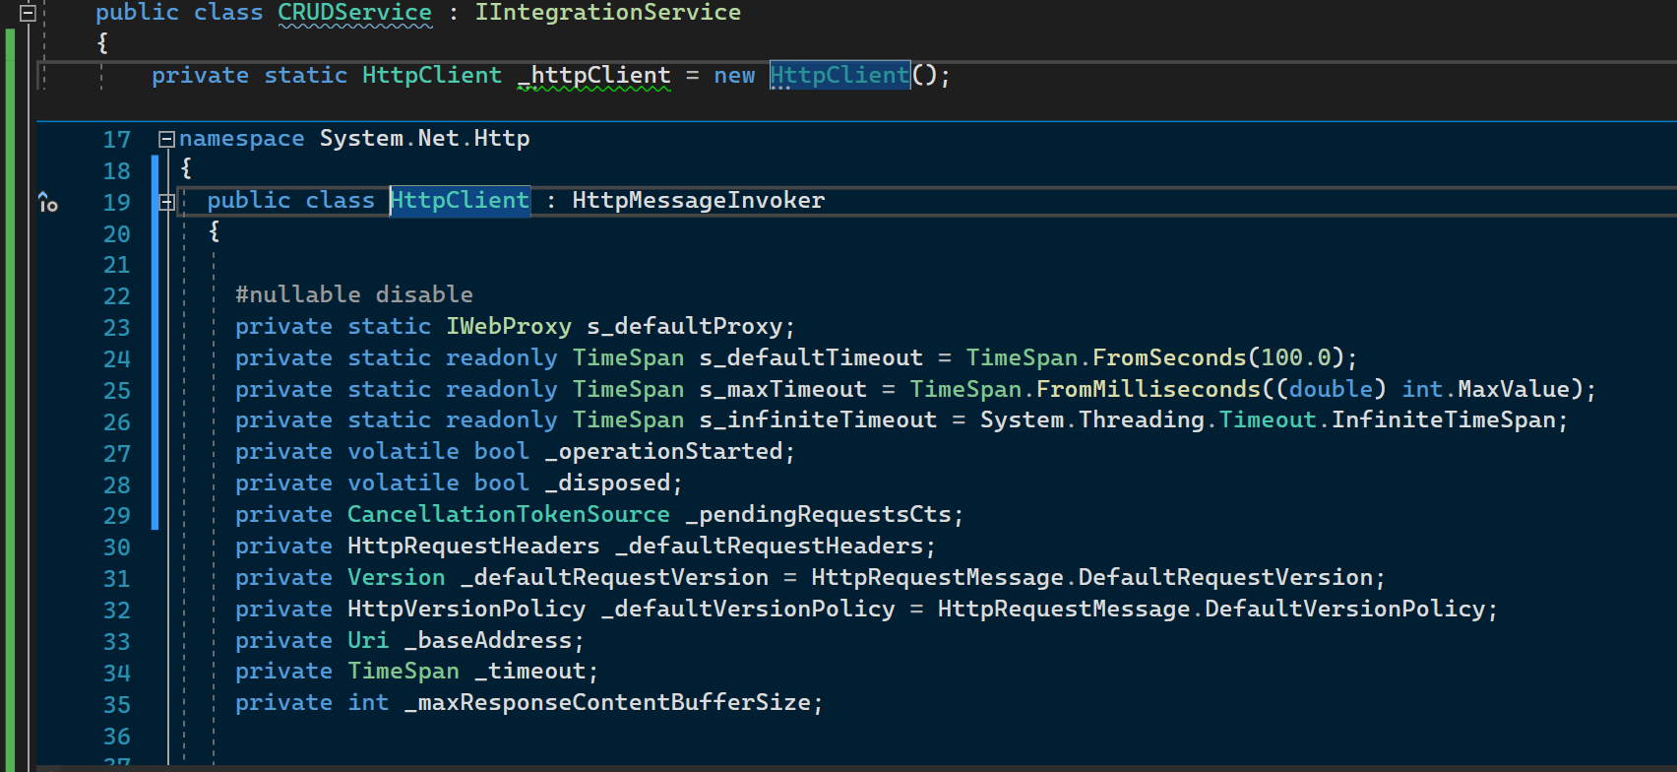
HTTP Client – Peek definition 1

Slide 39
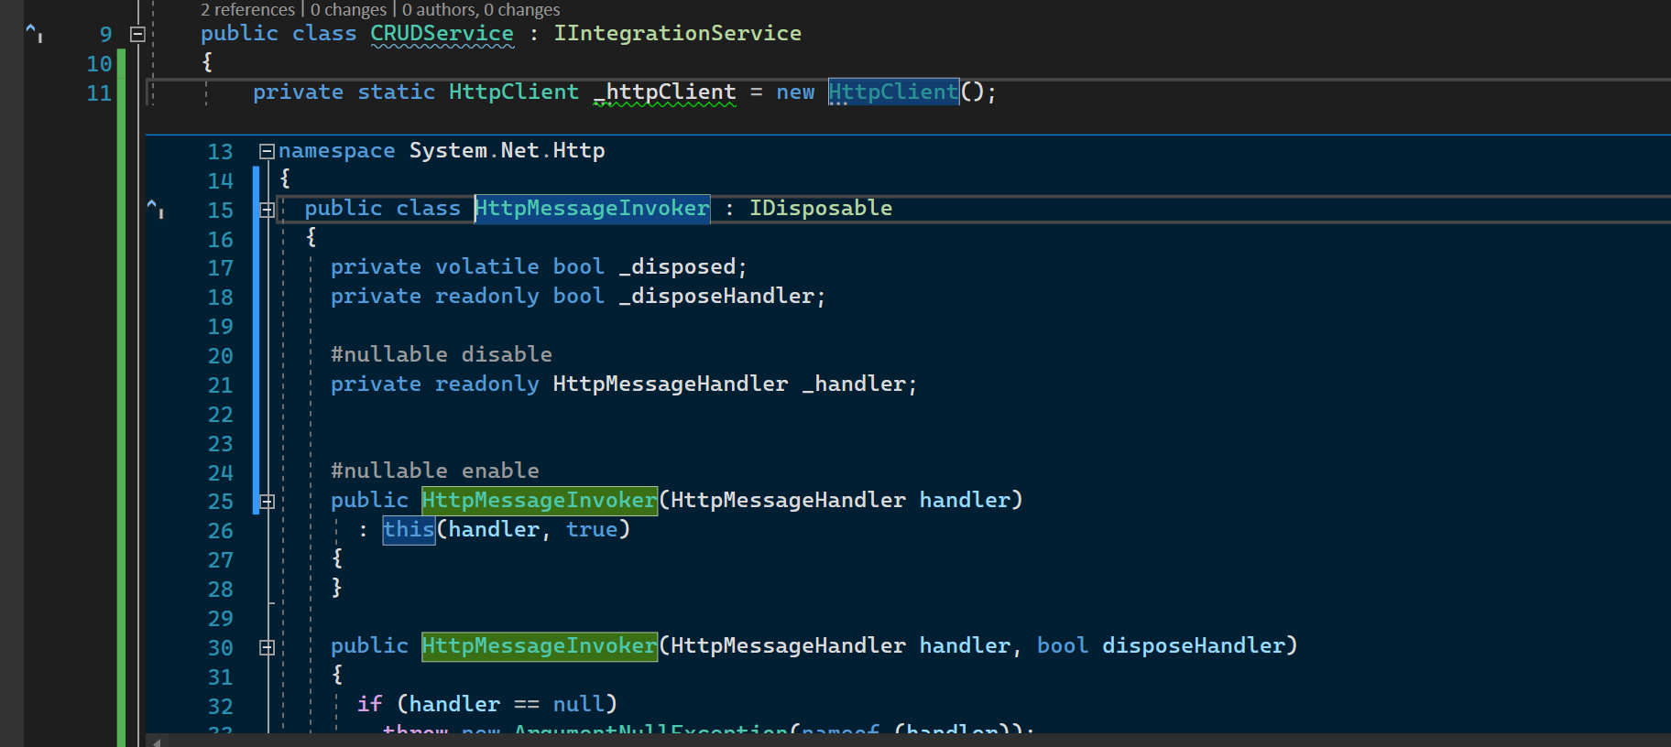
HTTP Client – Peek Definition 2

Slide 40
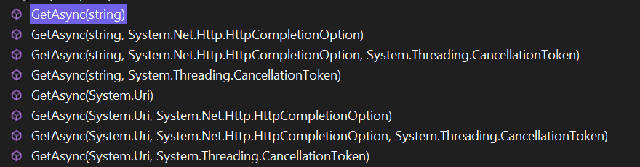
HTTP Client – GetAsync overloads

Slide 41
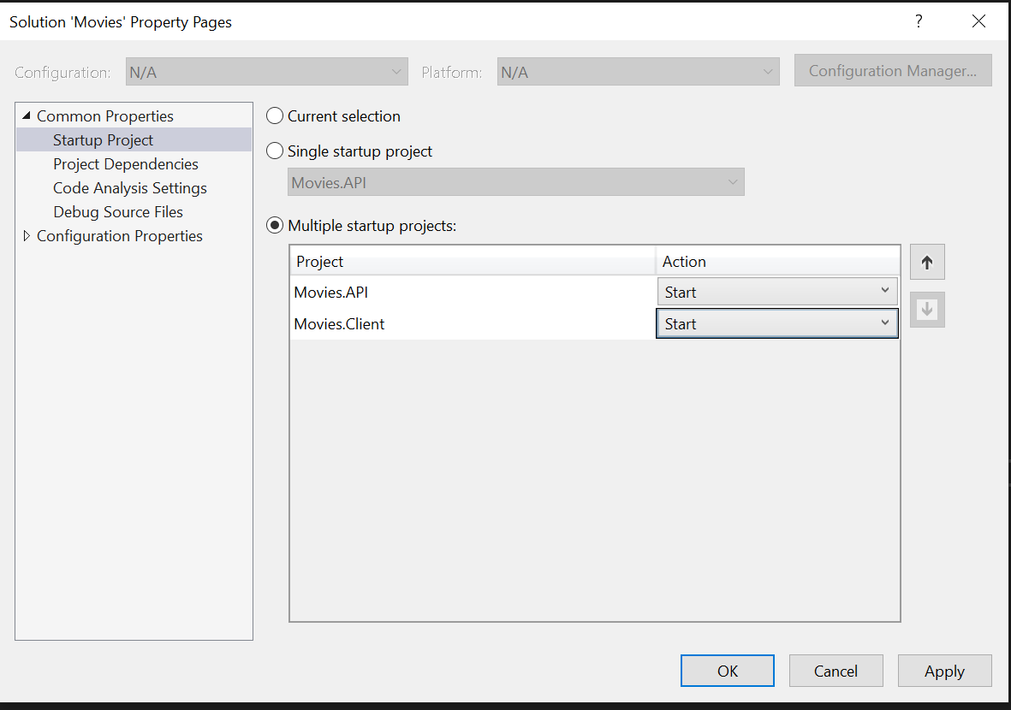
Start up projects

Slide 42
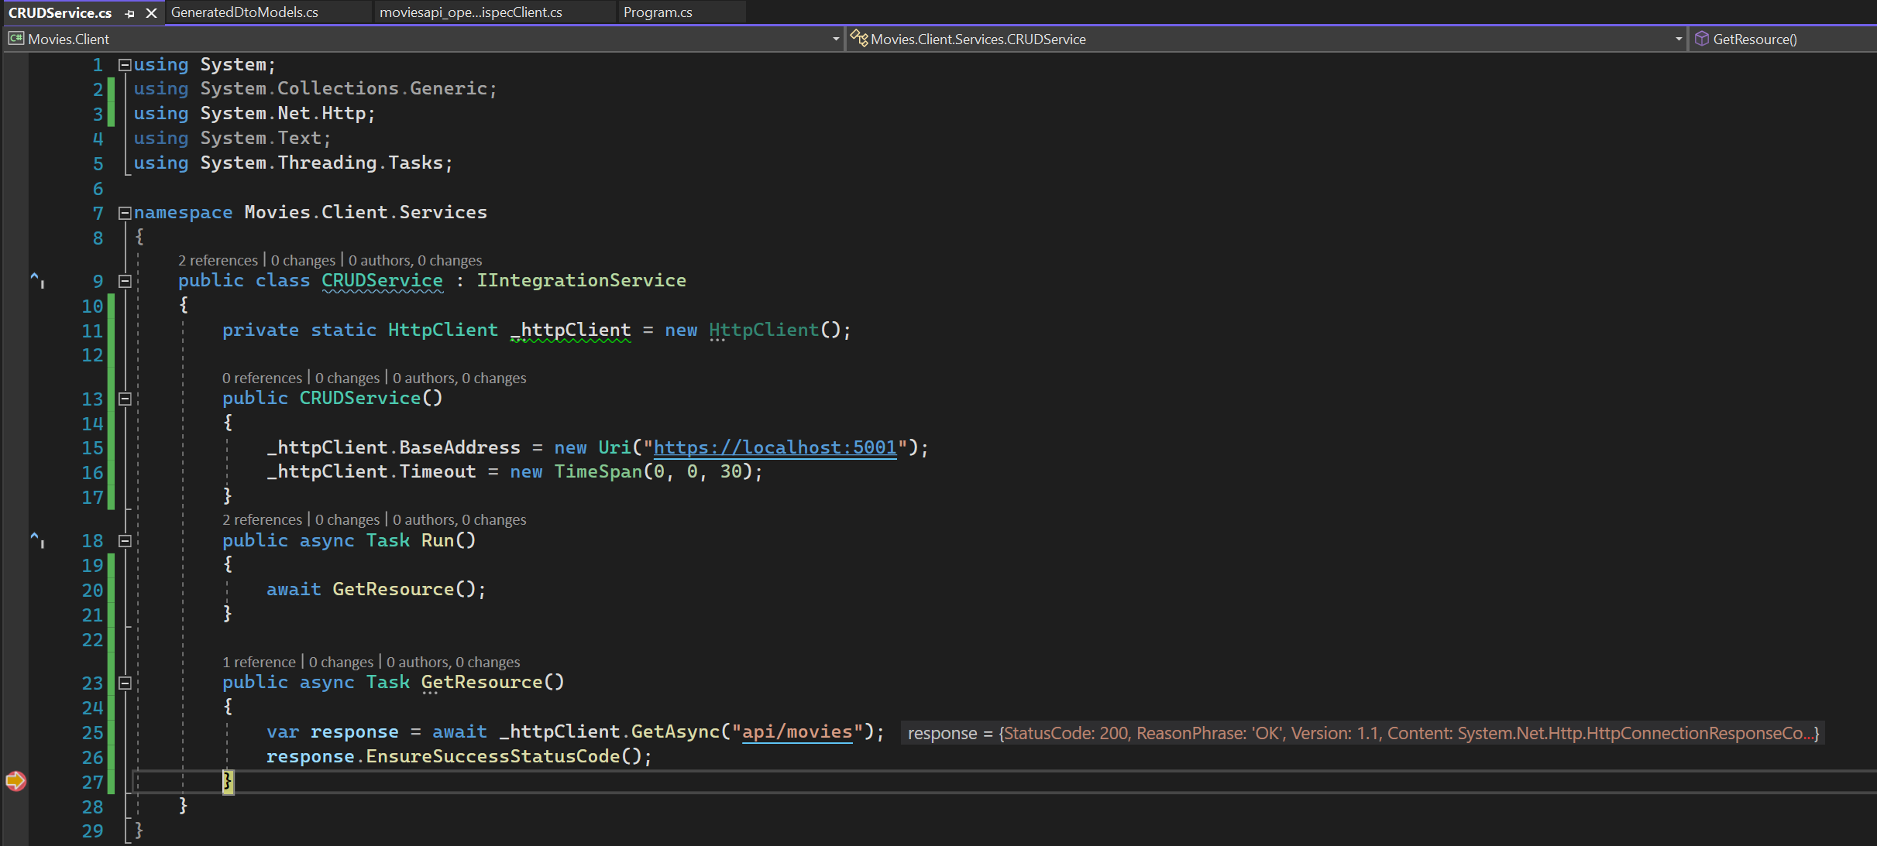
Basic READ CODE

Slide 43
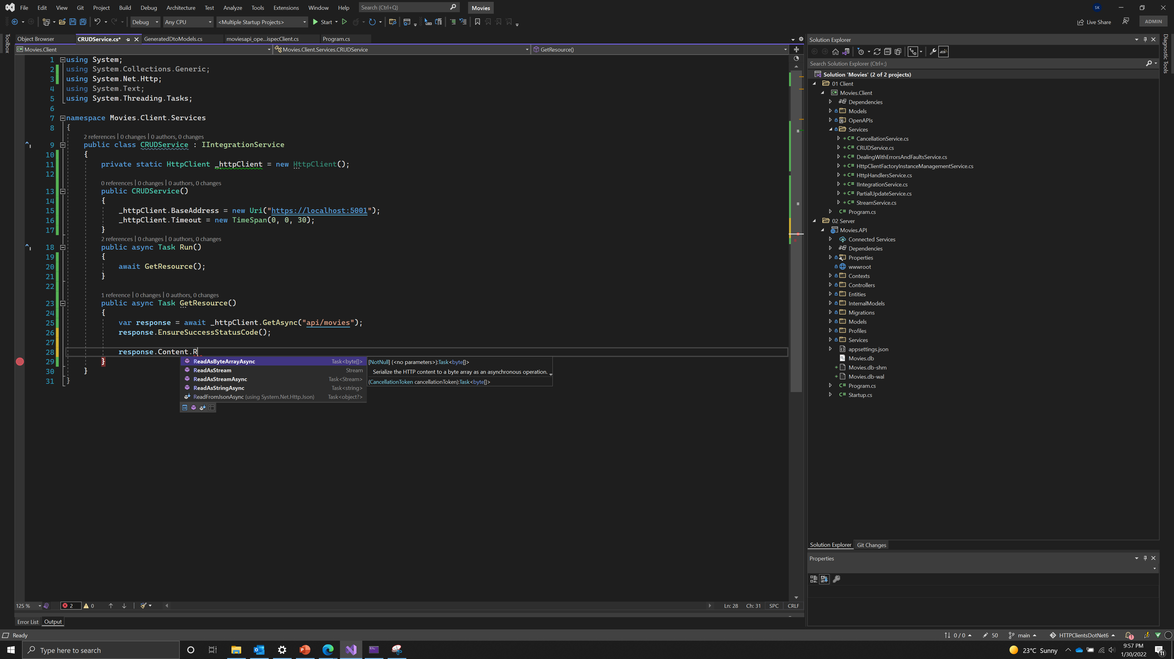
Overloads read

Slide 44
Overloads read

Slide 45
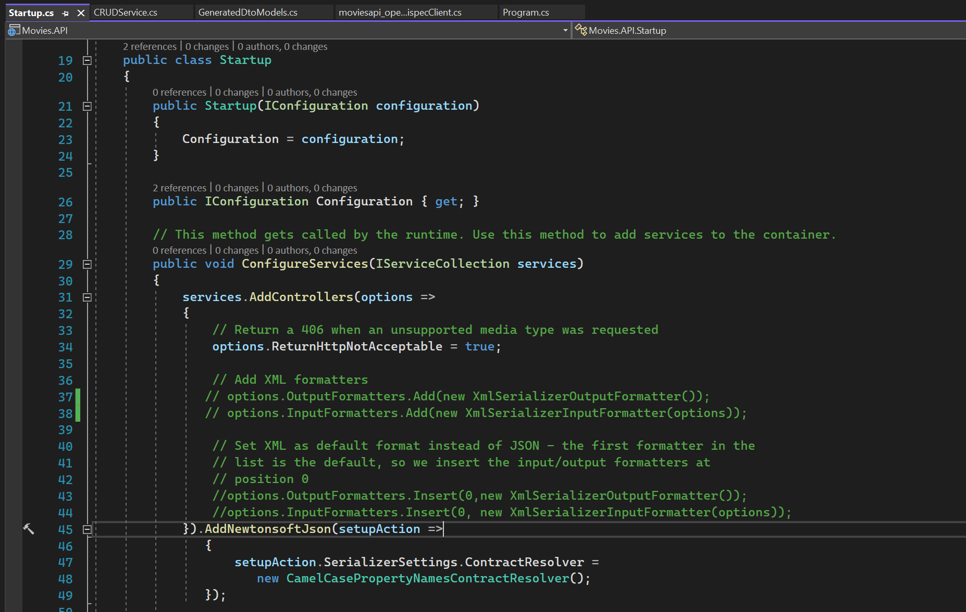
MOVIES API – Comment xml formatters

Slide 46
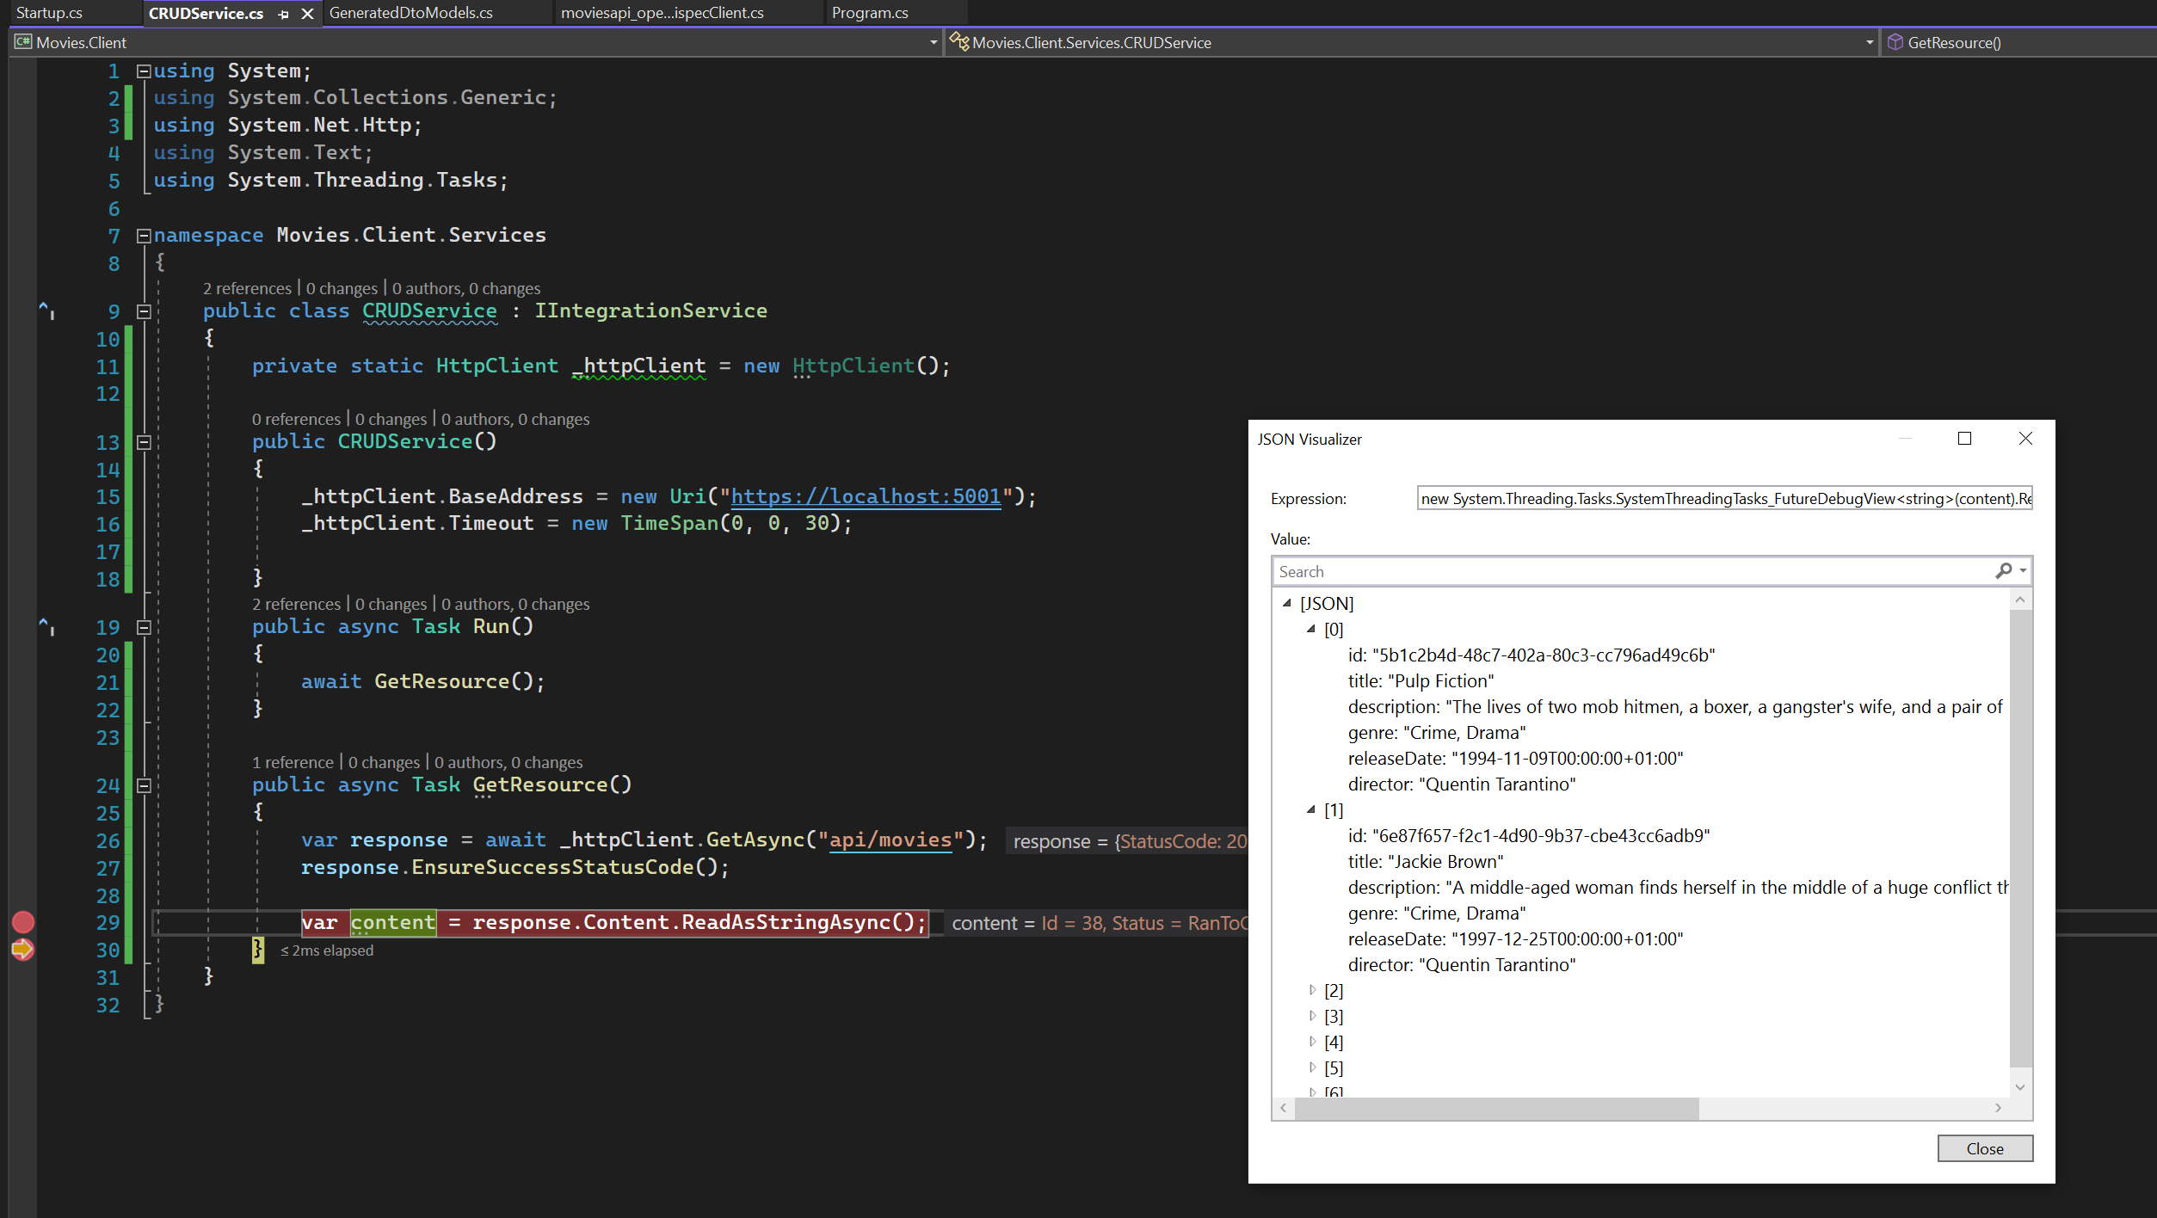
GET SERVICE

Slide 47
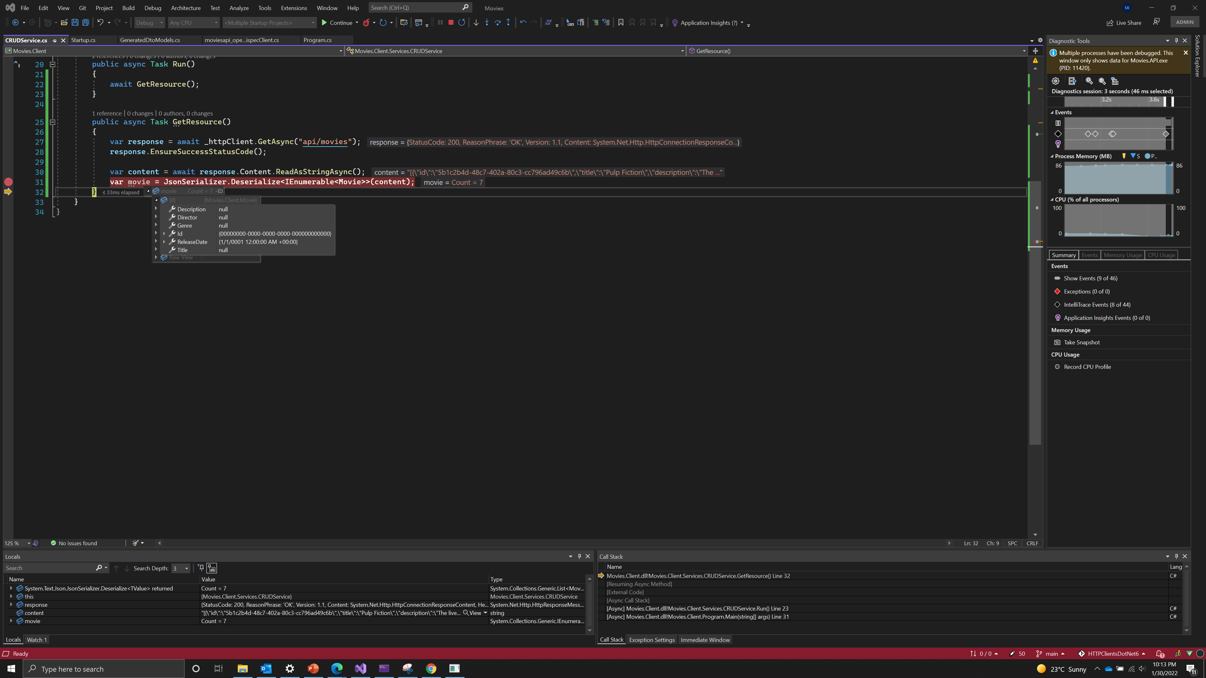
GET SERVICE – why NULL?

Slide 48
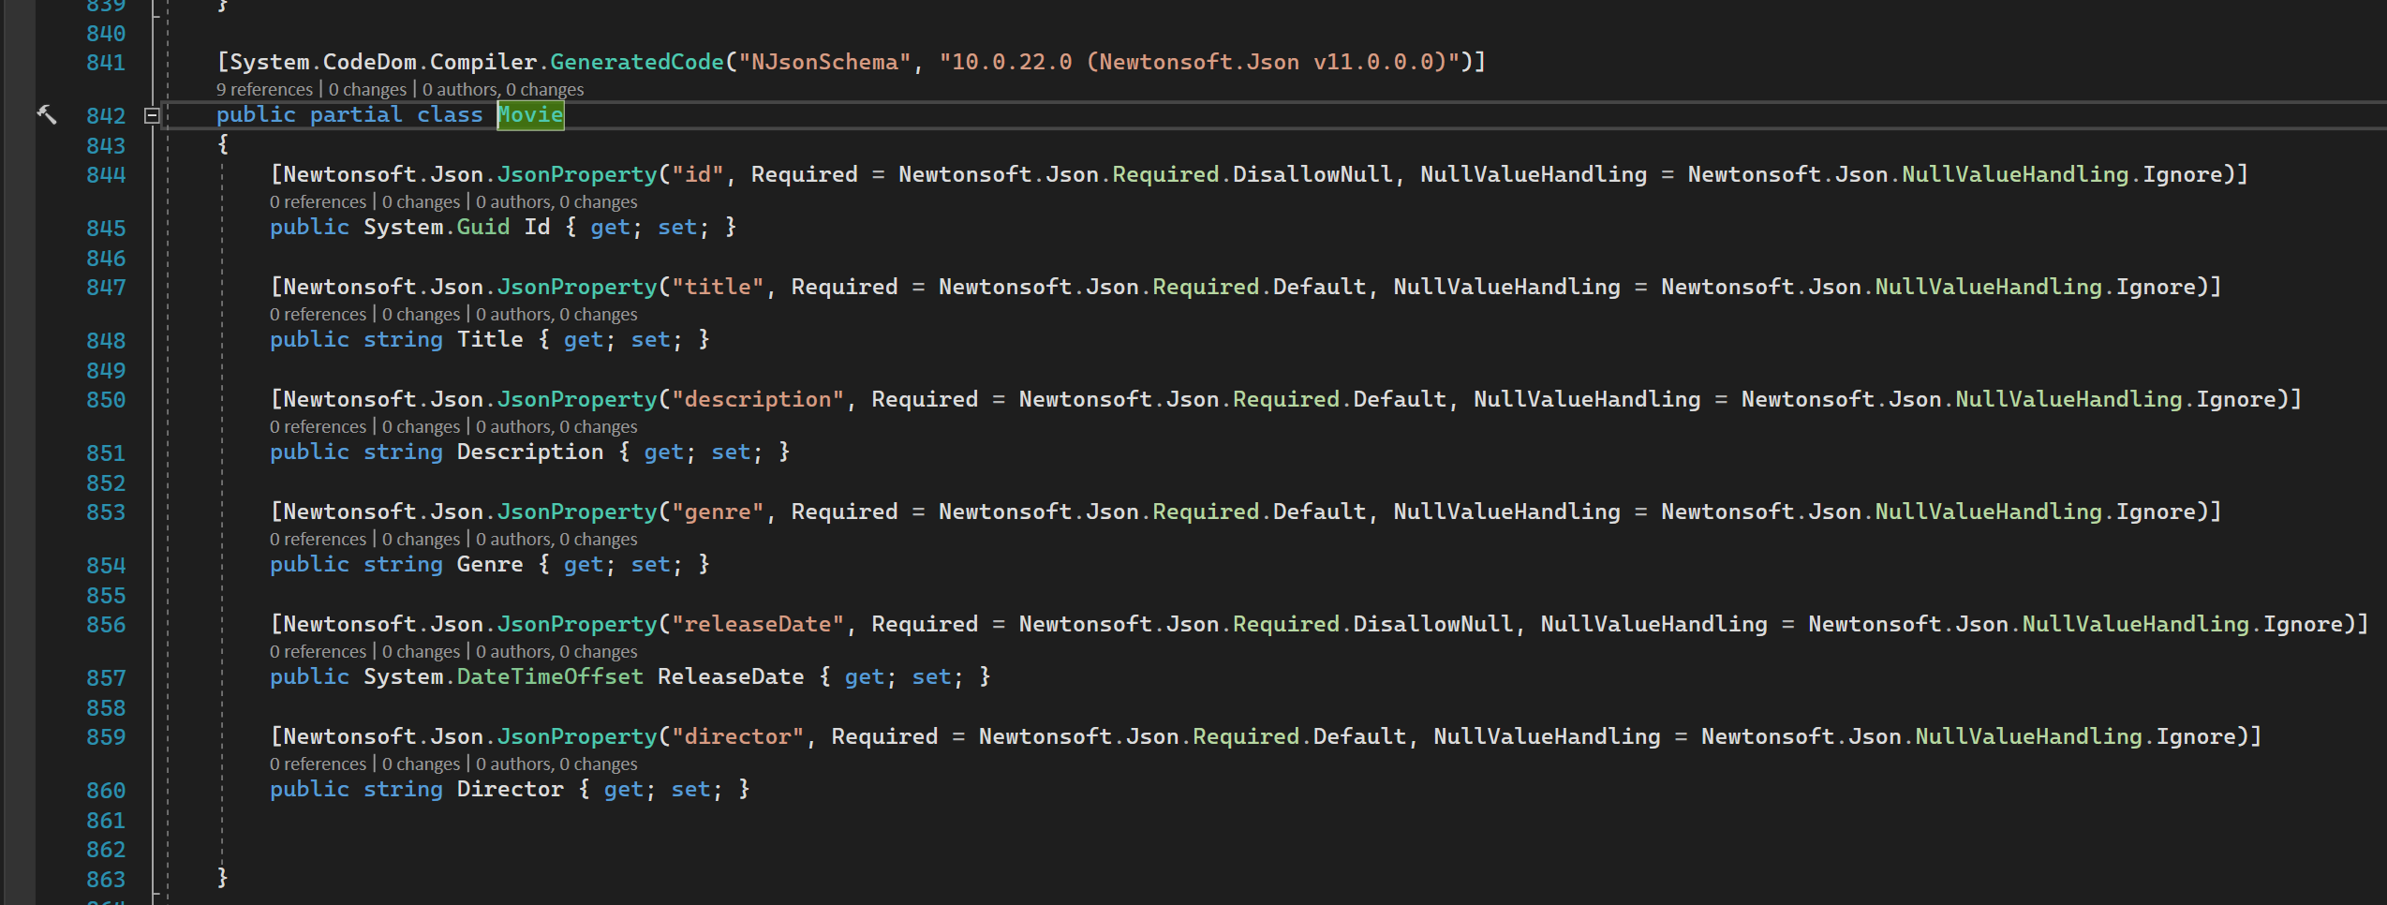
Observe dto – in camel case

Slide 49
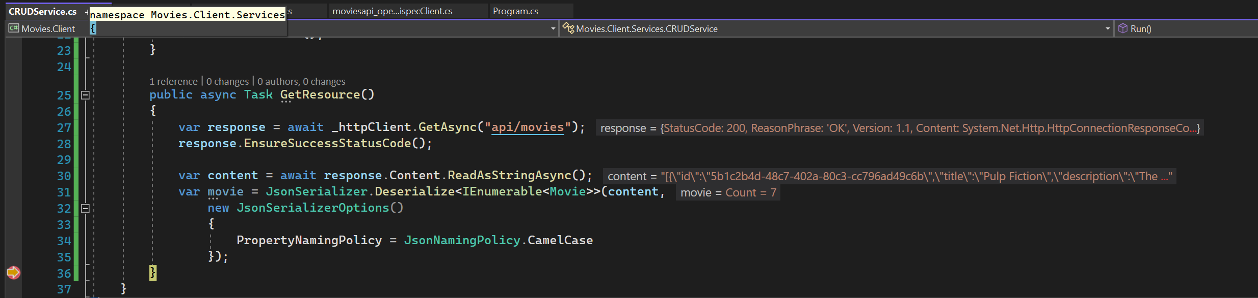
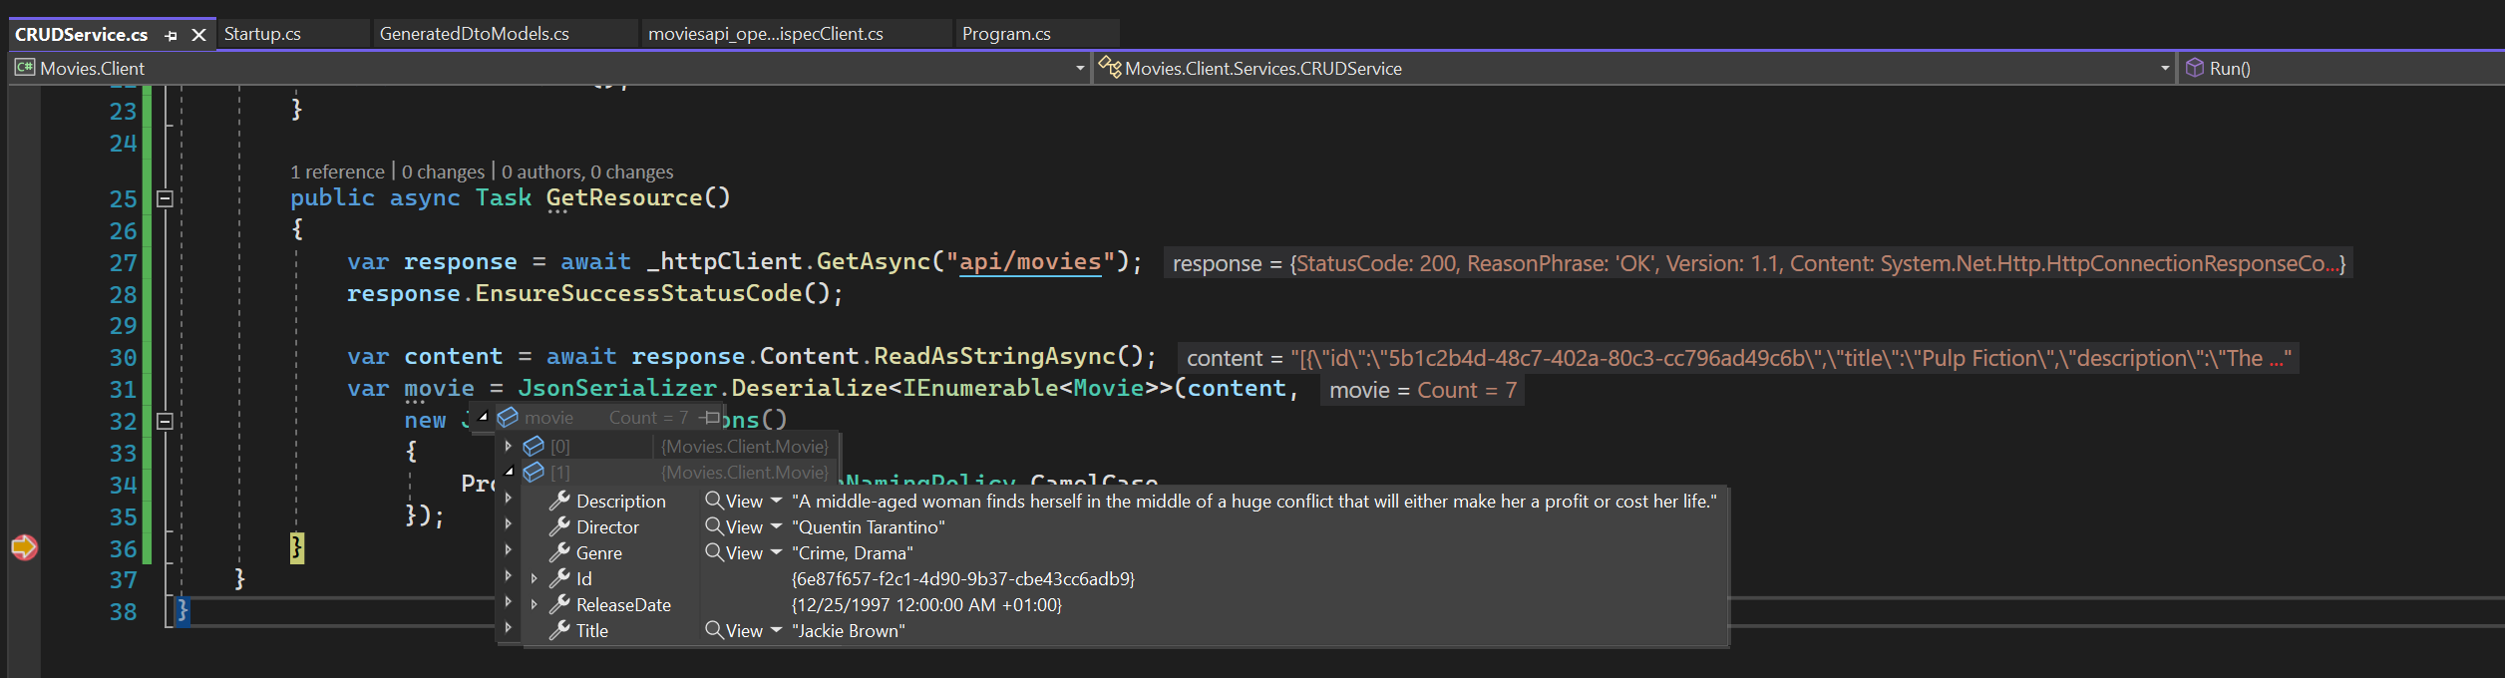
Fix get

Slide 50
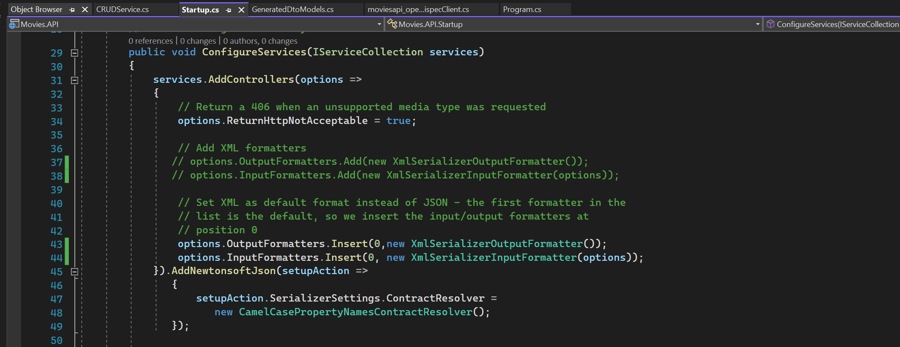
Set xml formatter

Slide 51
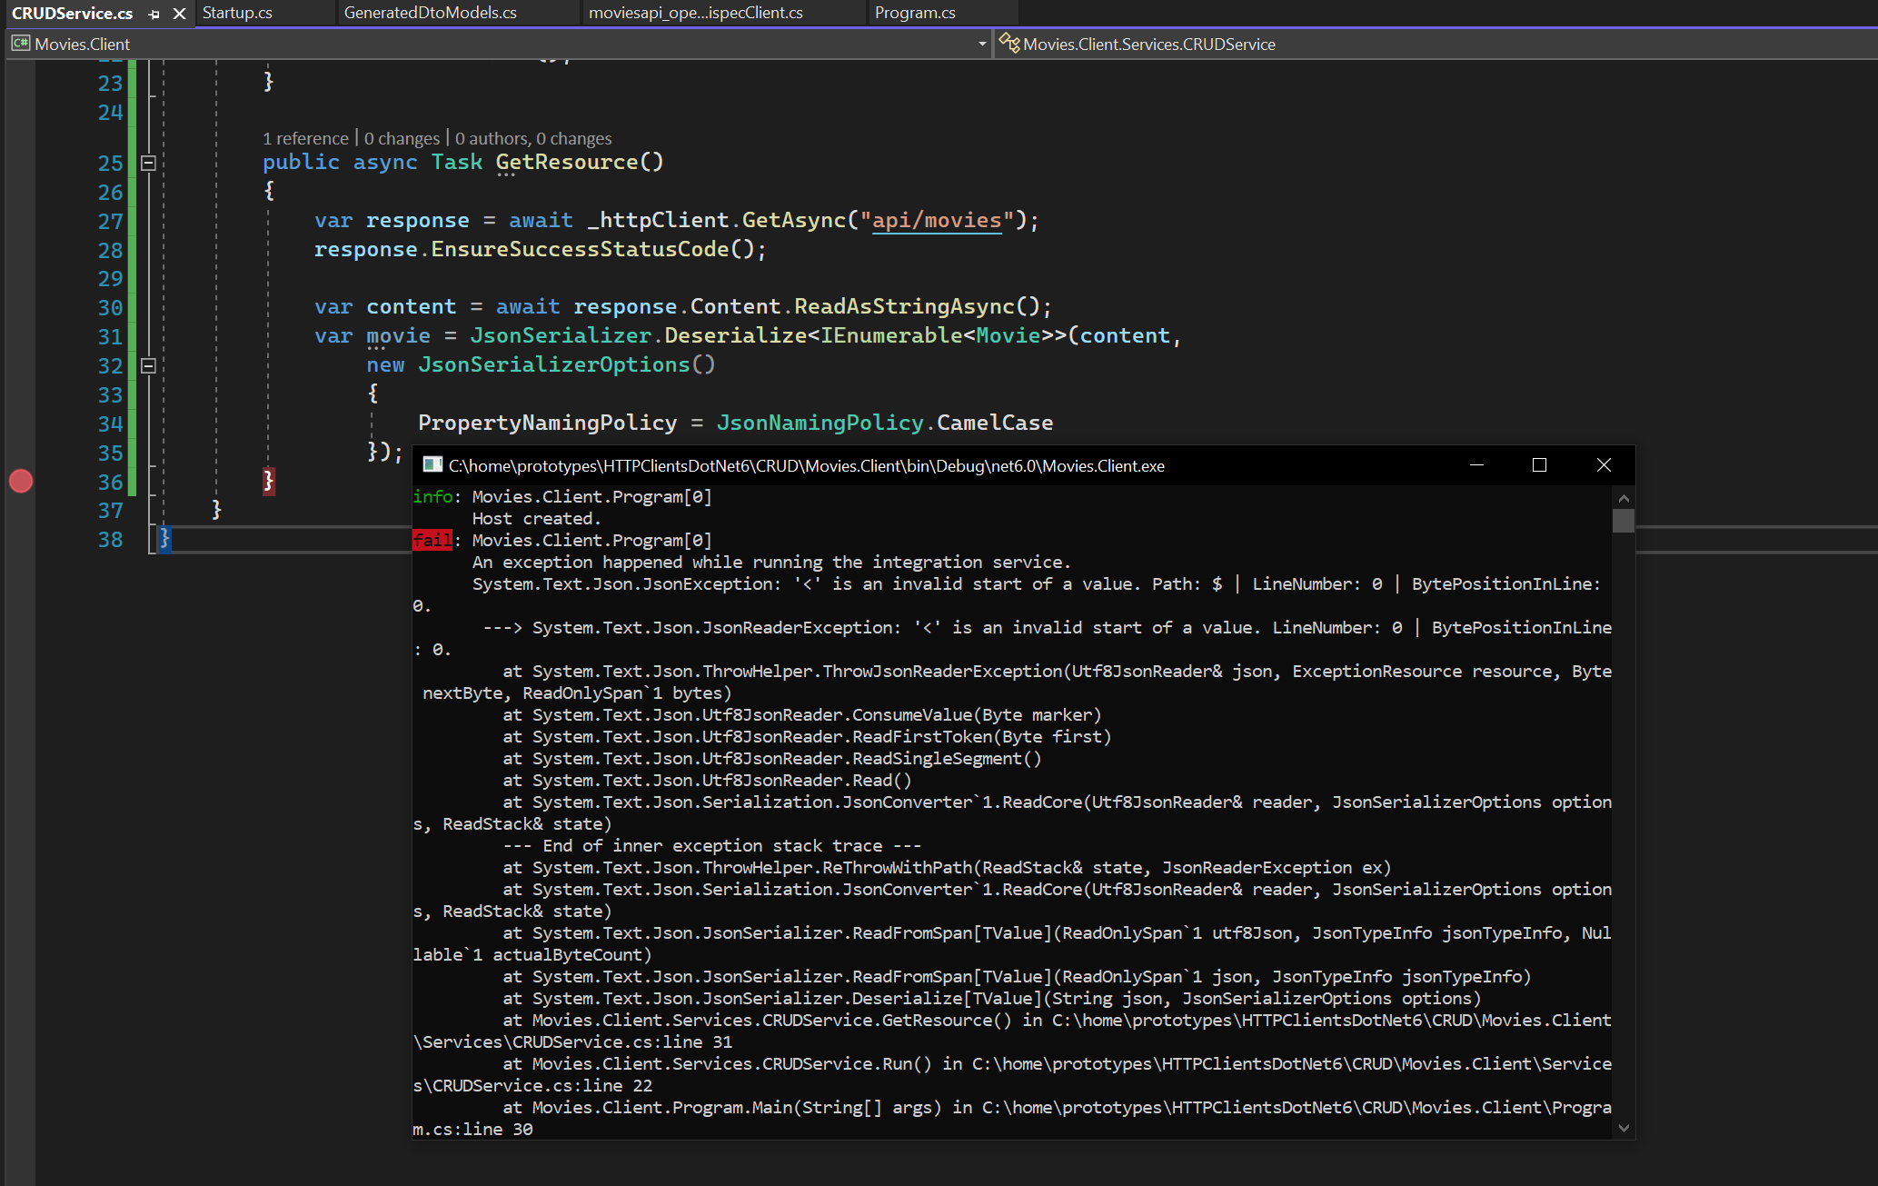
Application crashed

Slide 52
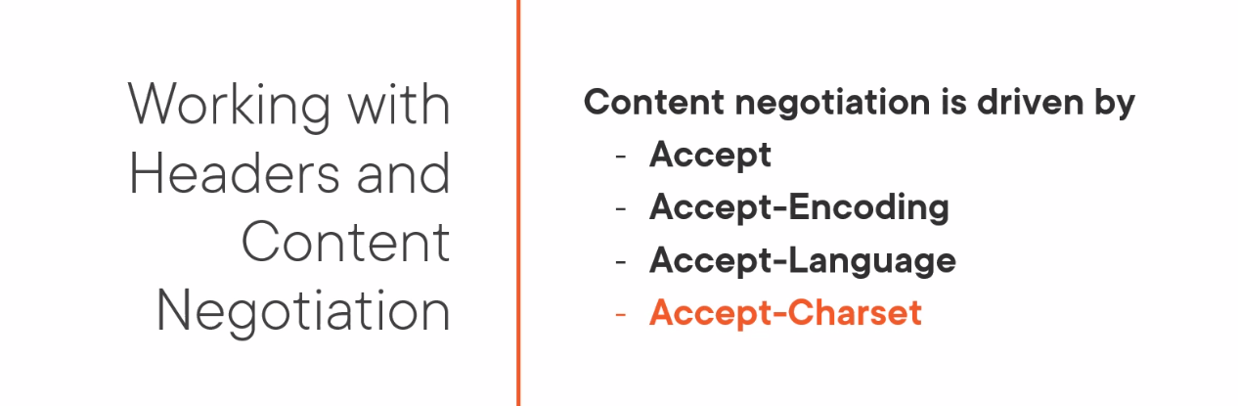
Headers and content negotiation

Slide 53
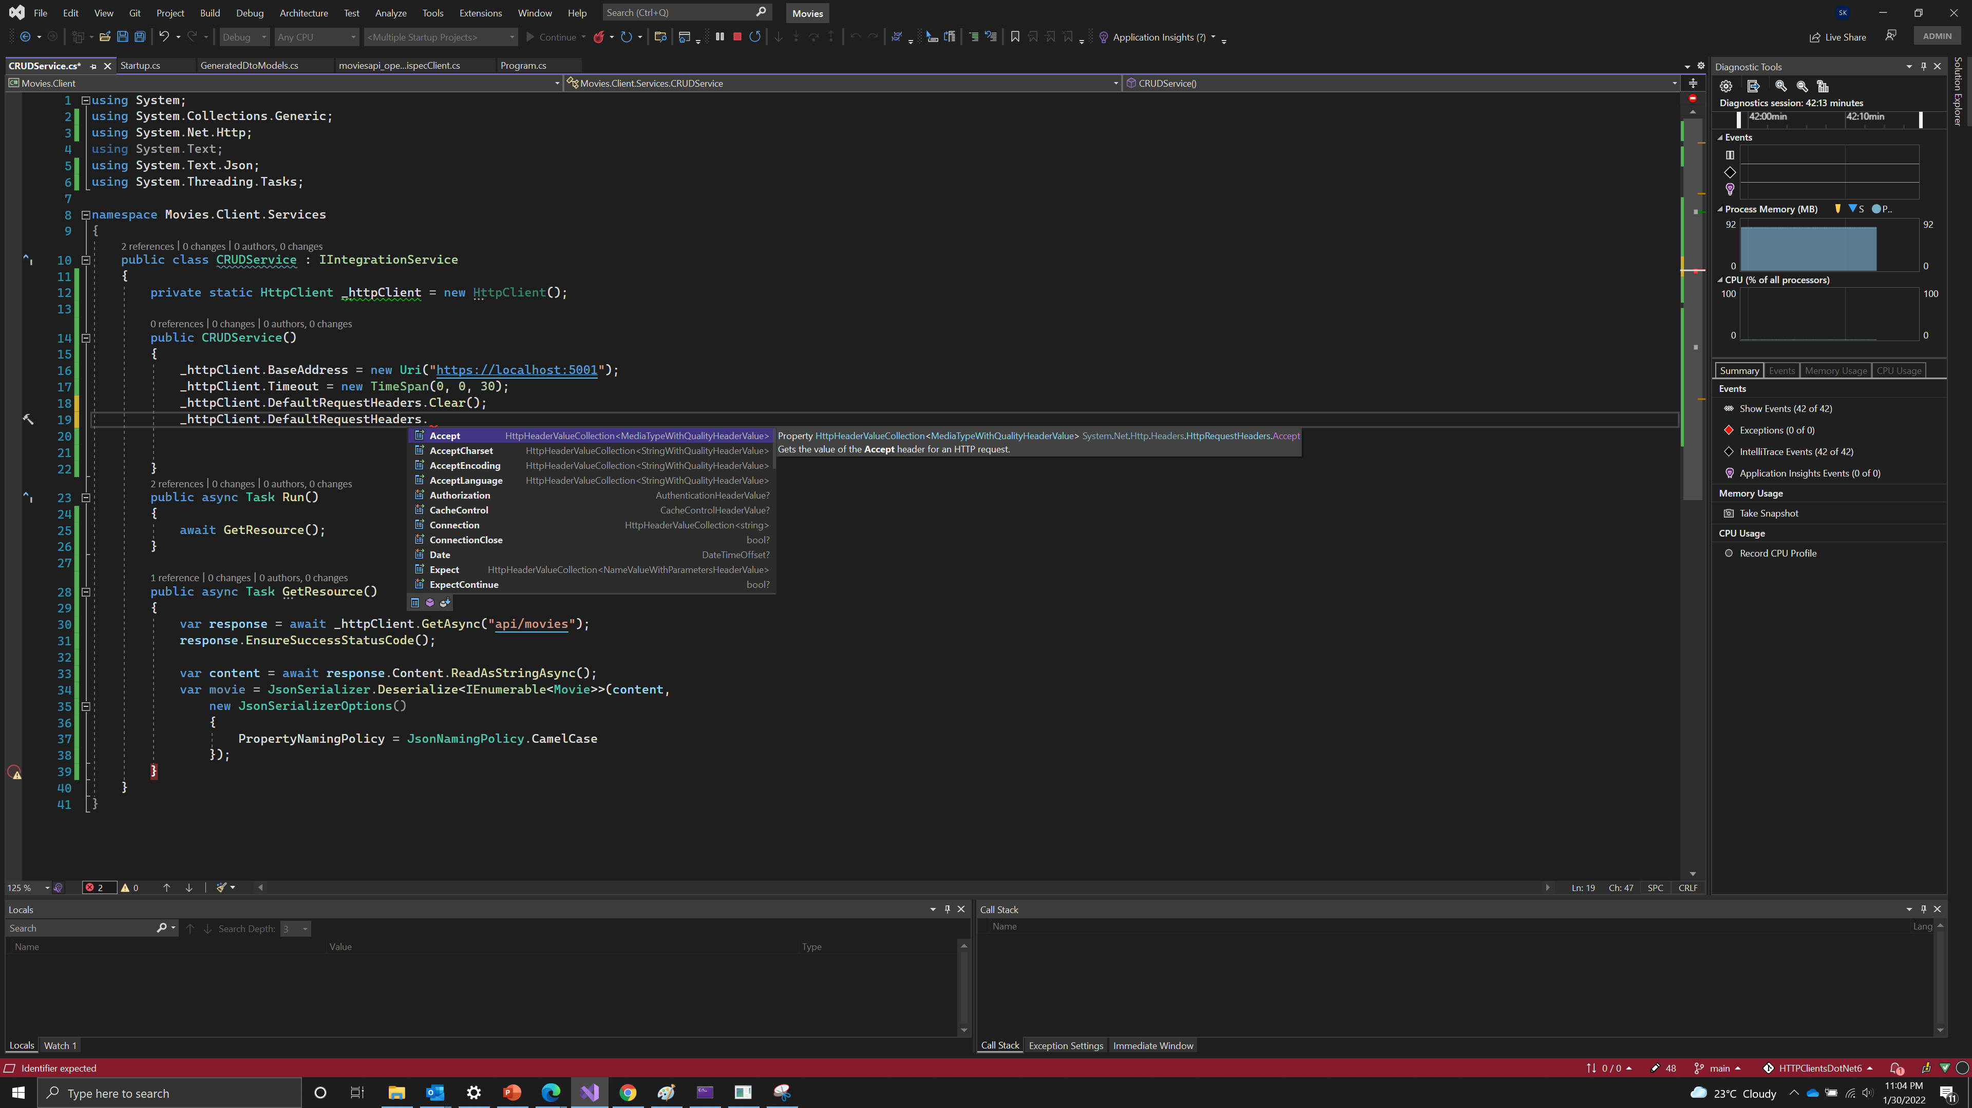
Manipulating request headers

Slide 54
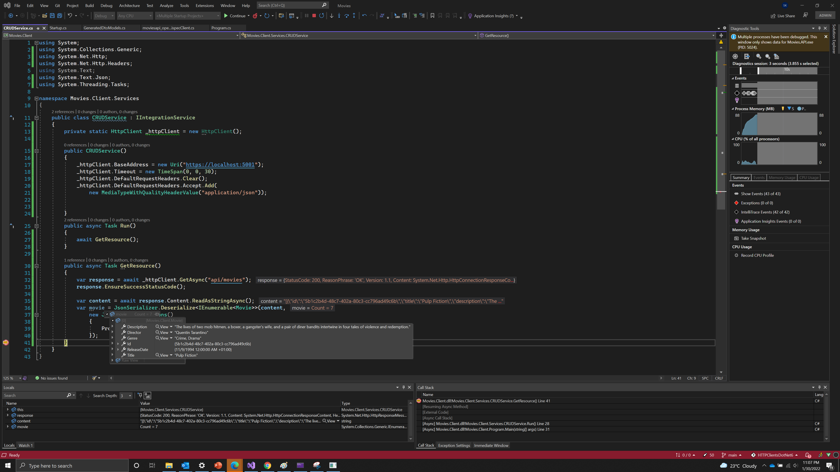
Request headers

Slide 55
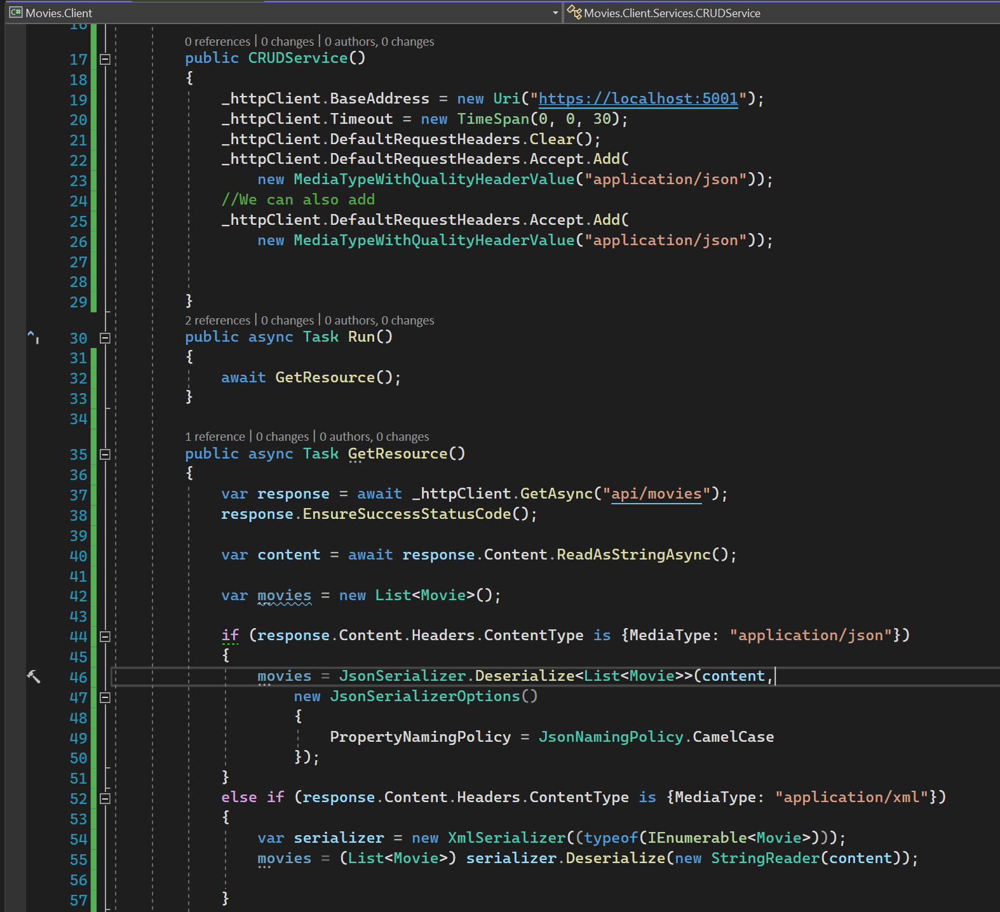
Supporting multiple content types
At line 26, just add application/xml
At line 54, typeof(List<Movie>)

Slide 56
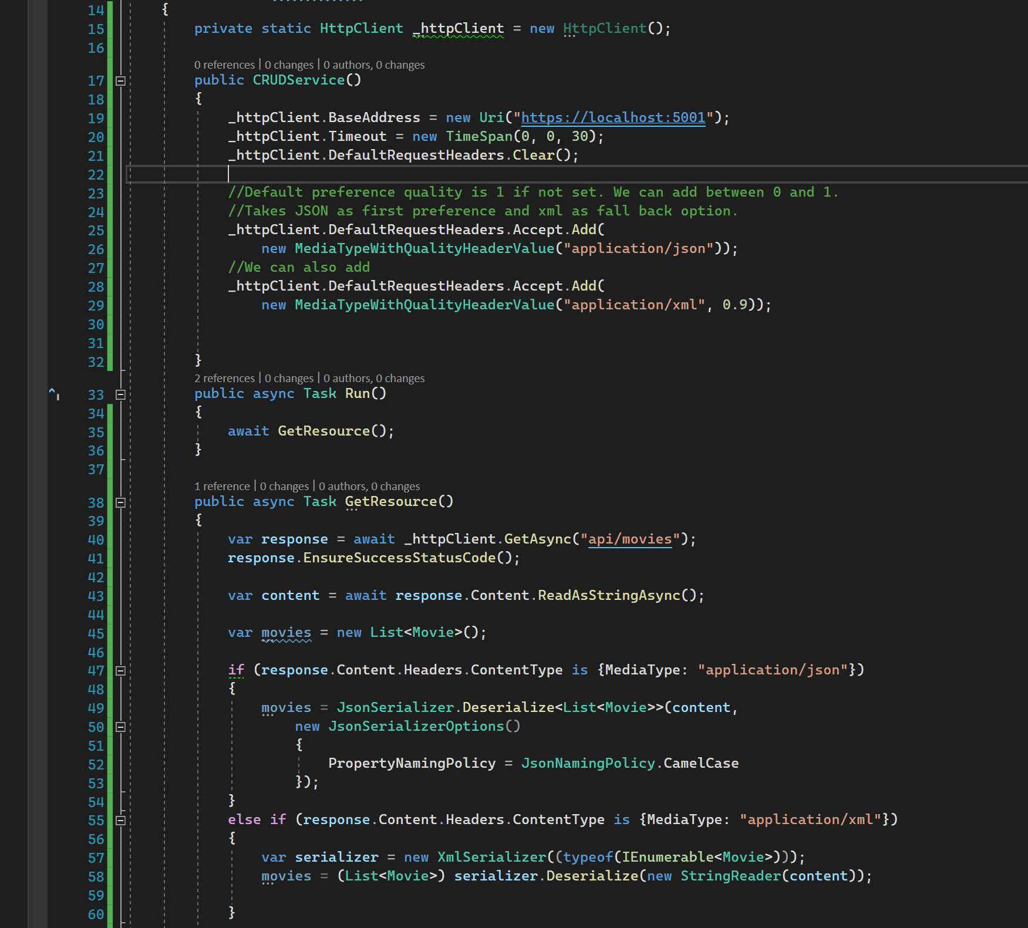
Preference with relative quality parameter

Slide 57

Check preference quality for any site

Slide 58

PROBLEM : HTTP CLIENT IS STATIC
The http client is static and the preference quality cannot be changed depending on the request
Http client is thread safe but its properties are not thread safe.

Slide 59

Request headers

Slide 60

Use httprequest message to avoid previous slide problem

Slide 61

Set movies api

Slide 62

Content types

Slide 63

Demo : create a resource

Slide 64

Demo : delete a resource

Slide 65

Demo : update a resource

Slide 66

Shortcuts : 1

Slide 67

Shortcuts : 2

Slide 68
Partial updates

Slide 69

Json patch
https://datatracker.ietf.org/doc/html/rfc6902

Slide 70

Install nuget package

Slide 71

See overloads

Slide 72

PATCH RESOURCE – Partial updates

Slide 73

Partial update service

Slide 74

Observe JSON patch

Slide 75

Observe the response

Slide 76

Patch shortcut

Slide 77

Newtonsoft.JSON vs system.text.json

Slide 78
Keep memory footprint of application as low as possible and performance high

Slide 79

Poster CODE
Working with largest sets of data, the memory and performance using streams became more apparent.

Slide 80

Enabling stream service - 1

Slide 81

Enabling stream service - 2

Slide 82

GET using stream

Slide 83

Observe output

Slide 84

Improve memory and use performance with HTTP Completion mode

Slide 85

Create extension method

Slide 86

Use extension methhod

Slide 87

TEST METHOD - 1

Slide 88

TEST METHOD - 2

Slide 89

TEST METHOD - 3

Slide 90

Set start without debugging

Slide 91

AVG milliseconds

Slide 92

POST using streams – Extension method

Slide 93

POST using streams

Slide 94

Read and post using streams

Slide 95

Marvin.streamEXTENSIONS

Slide 96

Comment out the code

Slide 97

Use Marvin.streamEXTENSIONS

Slide 98

TEST : POST poster without stream

Slide 99

TESTpostposterwithoutstream

Slide 100

TESTpostposterwithstream

Slide 101

TESTpostposterandreadwithstream

Slide 102

Post and read with streams

Slide 103
Cancellation - Beneficial to performance, both at level of bandwidth consumption as at level of scalability

Slide 104

Cancellation SERVICE

Slide 105

CANCELLATIONTOKENSOuRCE

Slide 106

cancellation

Slide 107

Cancellation service initialization

Slide 108

TASK cancelled exception

Slide 109

Use operation canceled exception

Slide 110

Observe operation cancelled exception

Slide 111

Handle timeout – make 2 seconds

Slide 112

Handle timeout exception

Slide 113

observe

Slide 114
Improving http client instance management with httpclient factory

Slide 115

HTTP CLIENT PROBLEM

Slide 116

CHECK SOCKETS

Slide 117

HTTP Requests

Slide 118

HTTP CONNECTIONS
netstat -abn
-a – We ensure that all connections are listed.
-b – We ensure we see the process holding onto the connection if its available.
-n – We want to see address and ports in numerical form.
TIME_WAIT : Nothing will be sent over these connections, but they can still receive packets from server.
This can remain open upto 240 secs.

Slide 119

Reuse http connections

Slide 120
TEST REUSE HTTP CLIENT

Slide 121

Using static http client

Slide 122

HTTP CLIENT FACTORY
Handler is held for two minutes by default.
Socket exhaustion Problem : Any request for a new HTTP Client can share a previously created handler and thus, connection as well.
DNS problem : Disposing of handlers after 2 mins solves DNS issues.

Slide 123

Add Nuget package

Slide 124

HTTP Client

Slide 125

Create http client factory

Slide 126

Named instances - 1

Slide 127

Named instances - 2

Slide 128


Add primary message handler

Slide 129

Typed instances - 1
Typed instances provided the same capabilities as named clients without need to use string as keys.

Slide 130

Typed instances - 2

Slide 131

Typed instances 3

Slide 132

Typed instances with configuration - 1

Slide 133

Typed instances with configuration - 2

Slide 134

Typed instances with configuration - 3

Slide 135

FINAL APPROACH - 1

Slide 136

FINAL APPROACH - 2

Slide 137

FINAL APPROACH - 3

Slide 138

Ensure success status code

Slide 139

Dealing with errors and faults

Slide 140
Dealing with errors and faults

Slide 141

Dealing with errors and faults

Slide 142

Movies client

Slide 143

exception

Slide 144

Writing errors

Slide 145
HTTPMESSAGE HANDLERS

Slide 146

HTTP MESSAGE HANDLER

